Slide 1
Final Bit part 2

Slide 2
Syllabus
• Appropriate selection of graphical representations
• Probability and significance, including the interpretation of significance and Type 1/Type 2 errors
• Factors affecting choice of statistical test, including levels of measurement
• The use of inferential analysis, including Spearman’s Rho, Mann Whitney, Wilcoxon, Chi-Squared
• Analysis and interpretation of qualitative data
• Conventions of reporting on psychological investigations

Slide 3
Primary data
An advantage of using primary data is that researchers are collecting information for the specific purposes of their study. In essence, the questions the researchers ask are tailored to elicit the data that will help them with their study. Researchers collect the data themselves, using surveys, interviews and direct observations.
Example Asch in conformity.

Slide 4
Secondary data
They can include information from the national population census and other government information collected by Statistics Canada. One type of secondary data that’s used increasingly is administrative data. This term refers to data that is collected routinely as part of the day-to-day operations of an organization, institution or agency. There are any number of examples: motor vehicle registrations, hospital intake and discharge records, workers’ compensation claims records, and more.
Compared to primary data, secondary data tends to be readily available and inexpensive to obtain. In addition, administrative data tends to have large samples, because the data collection is comprehensive and routine. What’s more, administrative data (and many types of secondary data) are collected over a long period. That allows researchers to detect change over time.
You may look at days sick in the workforce as a part of a study in stress. Or look at the criminal records of orphans?

Slide 5
meta-analysis
A meta-analysis statistically combines the results of several studies that address a shared research hypotheses.
Just as individual studies summarize data collected from many participants in order to answer a specific research question (i.e., each participant is a separate data-point in the analysis), a meta-analysis summarizes data from individual studies that concern a specific research question (i.e., each study is a separate data-point in the analysis).
Eg: Van Ijzendoorn & Kroonenberg (1988) wanted to investigate if attachment styles (secure and insecure) are universal (the same) across cultures, or culturally specific (vary considerably from place to place, due to traditions, the social environment, or beliefs about children).
They did not collect the data for their study, instead they analysed data from other studies using a method called meta analysis. Data from 32 studies in 8 different countries was analysed.
All the 32 studies used the strange situation procedure to study attachment. Using a meta analysis (statistical technique) they calculated the average percentage for the different attachment styles (e.g. secure, avoidant, resistant) in each country.

Slide 6
Levels of measurement: nominal, ordinal and interval.
In nominal measurement the numerical values just "name" the attribute uniquely. No ordering of the cases is implied. For example, jersey numbers in basketball are measures at the nominal level. A player with number 30 is not more of anything than a player with number 15, and is certainly not twice whatever number 15 is.
In ordinal measurement the attributes can be rank-ordered. Here, distances between attributes do not have any meaning. For example, on a survey you might code Educational Attainment as 0=less than high school; 1=some high school.; 2=high school degree; 3=some college; 4=college degree; 5=post college. In this measure, higher numbers mean more education. But is distance from 0 to 1 same as 3 to 4? Of course not. The interval between values is not interpretable in an ordinal measure.
In interval measurement the distance between attributes does have meaning. For example, when we measure temperature (in Fahrenheit), the distance from 30-40 is same as distance from 70-80. The interval between values is interpretable. Because of this, it makes sense to compute an average of an interval variable, where it doesn't make sense to do so for ordinal scales. But note that in interval measurement ratios don't make any sense - 80 degrees is not twice as hot as 40 degrees

Slide 7
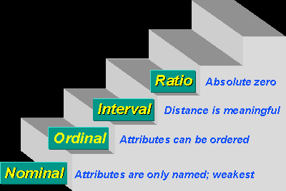

Slide 8
Factors affecting choice of statistical test, including levels of measurement.
Nominal data: Categories, counting the frequency of data (tally charts)
Ordinal data: Rank-ordering of data, e.g. scores, position
Interval data: Standardised measurement units e.g. time, weight, temp.
Choose based on:
Difference/relationship
Related/unrelated (Same participants/Different)
Level of data
Nominal, unrelated, difference = Chi squared test
Ordinal, unrelated, difference = Mann-Whitney U test
Ordinal, related, difference = Wilcoxon
Ordinal, related, relationship = Spearman’s Rank

Slide 9
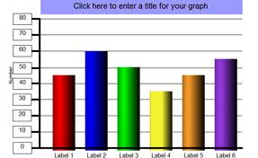
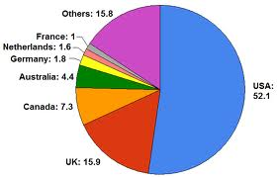
Presentation and Analysis of Data

Slide 10
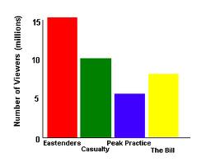
Bar Charts
A bar chart is used for nominal data. This is data placed in mutually exclusive categories (e.g. name of your school).
It consists of a set of vertical bars with a space between each of them, each bar represents a different category and can be placed in any order on the x-axis.
The categories are shown on the x-axis and the frequency of each category is shown on the y-axis.

Slide 11
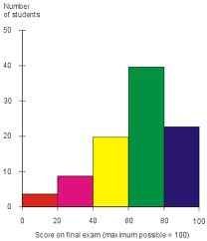
Histograms
A histogram is used for ordinal data or interval data, this is data that can be put into rank order.
They consist of a series of vertical lines of equal width, there is no space between the bars.
The units of measurement are shown on the x-axis, single values can be used or data can be grouped.

Slide 12
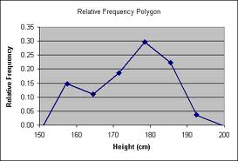
Frequency Polygon
This can be used as an alternative to a histogram.
It is particularly useful when you need to show two sets of data on the same graph.

Slide 13
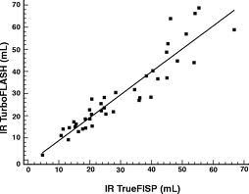
Scattergram
This is used for showing the relationship between two variables (e.g. correlations).
Data from one variable are shown on the y-axis and data from the other variable are shown on the x-axis.
The closer the points on the graph are to a straight line the stronger the correlation.

Slide 14
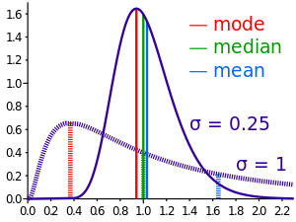
Measures of Central Tendency
These are single values which represent a set of numbers by providing the most typical value.
The mean is calculated by adding all the scores and then dividing by the total number of scores.
Advantages;
takes account of all scores.
Disadvantages;
can easily be distorted by a single extreme value in the set.

Slide 15
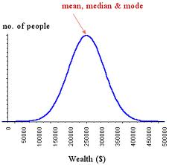
The median is calculated by ranking all the scores in order and taking the middle value.
Advantages;
can be used on ordinal and interval data,
unaffected by extreme scores.
Disadvantages;
not as useful for small sets of data,
can be unrepresentative of the data if scores are clustered around high and low values.

Slide 16

The mode is the most frequent value.
Advantages;
easy to calculate,
works on nominal data,
unaffected by extreme scores.
Disadvantages;
tells us nothing about other scores in the set,
limited usefulness if there is more than one modal score,
not useful for small sets of data.

Slide 17
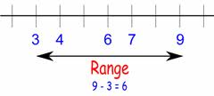
Measures Dispersion
These show how the scores in a set are spread out, this tells us whether scores are similar to each other or if they vary widely.
The range is the difference between the highest and lowest scores in a set of data.
Advantages;
quick and easy to calculate.
Disadvantages;
can be easily distorted by extreme values.

Slide 18
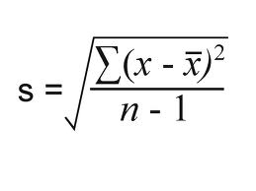
The standard deviation is the average amount that each scores differs from the mean.
Advantages;
takes account of all scores.
Disadvantages;
more difficult to calculate then the range,
can only be used on interval data.

Slide 19
Probability and significance, including the interpretation of significance and Type 1/Type 2 errors
Looking for significance:
• In psychology, we look for the P≤0.05 value
• This means that the results could be 5% due to chance, however we are 95% sure the value is significant

Slide 20
Type 1 and type 2 errors ): Link
Type 1:
• Reject Null (accept alternative hypothesis)
• Likely to occur if the probability is TOO LENIENT
• E.g. from using P≤0.10 instead of P≤0.05
Type 2:
• Accept null (reject alternative hypothesis)
• Likely to occur if the probability is TOO STRINGENT
• E.g. From using P≤0.01instead of P≤0.05

Slide 21
Try again
Type 1 error (false positive) – you believe the null hypothesis isn’t true (and reject it) but in reality the null hypothesis is true. So, in the case of shoe laces you believe shoe laces and luck are linked but, in reality, there is no link. Or you avoid mushrooms for ever after because you think they will make you die but this link is mistaken.
Type 2 error (false negative) – you believe the null hypothesis is true (and accept it) when in reality the null hypothesis is not true. In the case of shoe laces and luck, you believe tying your shoe laces twice has no effect on luck but in fact it has. Or you believe that red mushrooms don’t cause death but they do.

Slide 22
Types of test
Spearman’s rho
Spearman’s rho is a test for significant association, and produces a correlation coefficient. The level of measurement must be either ordinal or interval. The research design can be either related or unrelated.
Wilcoxon signed ranks test
Wilcoxon signed ranks is a test of significant difference for related data. The research design must produce related data (e.g. repeated measures or matched pairs). The level of measurement can be either ordinal or interval.
Mann-Whitney U test
Mann-Whitney U is a test of significant difference for unrelated data. The research design must produce unrelated data (e.g. independent measures). The level of measurement can be either ordinal or interval.
Chi-square test
Chi-square tests for difference when the data is nominal and unrelated. The research design must produce unrelated data (e.g. independent measures). The level of measurement must be nominal (e.g. categories).

Slide 23
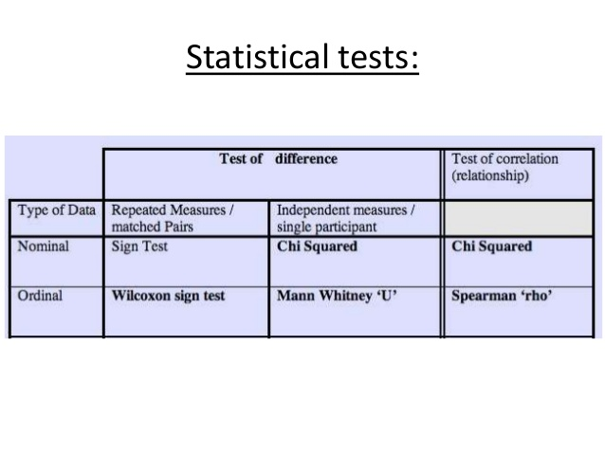

Slide 24
How to write up for a 10 mark question
1. Hypothesis (1 vs 2 tailed, operationalise variables)
2. Research method (might be in given text, justify)
3. Experimental design (related/unrelated, justify)
4. List variables (explain fully, operationalise, explain why an EV is an EV)
5. Participants (target population, age, gender, location)
6. Sampling (which technique, size, justify)
7. Materials (questionnaire open/closed? Data qualititative/quantitive?)
8. Procedure (very clear, from approach p.s to debrief)
9. Appropriate stats test.

