Slide 1
Distributions: normal and skewed distributions; characteristics of normal and skewed distributions.

Slide 2
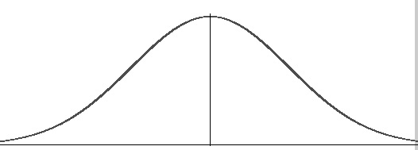
Normal Distribution
A normal distribution, sometimes called the bell curve, is a distribution that occurs naturally in many situations. For example, the bell curve is seen in tests like the SAT and A levels. The bulk of students will score the average (C), while smaller numbers of students will score a B or D. An even smaller percentage of students score an U or an A. This creates a distribution that resembles a bell (hence the nickname). The bell curve is symmetrical. Half of the data will fall to the left of the mean; half will fall to the right.
Many groups follow this type of pattern. That’s why it’s widely used in business, statistics and in government bodies:
Heights of people.
Measurement errors.
Blood pressure.
Points on a test.
IQ scores.
Salaries.

Slide 3
Standard Deviation
The empirical rule tells you what percentage of your data falls within a certain number of standard deviations from the mean:
• 68% of the data falls within one standard deviation of the mean.
• 95% of the data falls within two standard deviations of the mean.
• 99.7% of the date falls within three standard deviations of the mean.

Slide 4
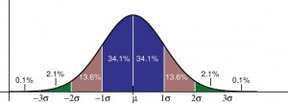
Standard Deviation
The standard deviation controls the spread of the distribution. A smaller standard deviation means that the data is tightly clustered around the mean; the normal distribution will be taller. A larger standard deviation means that the data is spread out around the mean; the normal distribution will be flatter and wider.

Slide 5
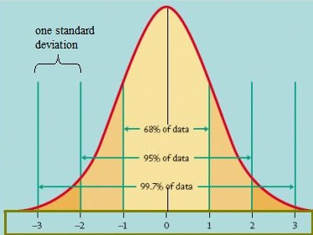
Possibly taller tighter packed

Slide 6
Properties of a normal distribution
The mean, mode and median are all equal.
The curve is symmetric at the center (i.e. around the mean, μ).
Exactly half of the values are to the left of center and exactly half the values are to the right.
The total area under the curve is 1.

Slide 7
Skewed Distribution
A distribution is skewed if one tail is longer than another. These distributions are sometimes called asymmetric or asymmetrical distributions as they don’t show any kind of symmetry. Symmetry means that one half of the distribution is a mirror image of the other half (normal distribution).

Slide 8
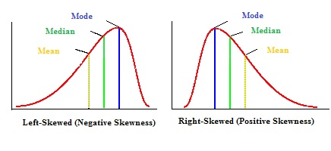
Negatively skewed
A left-skewed distribution has a long left tail. Left-skewed distributions are also called negatively-skewed distributions. That’s because there is a long tail in the negative direction on the number line. The mean is also to the left of the peak.

Slide 9
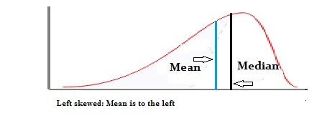
negative distribution will have the mean to the left of the median.

Slide 10
Positive skew
A right-skewed distribution has a long right tail. Right-skewed distributions are also called positive-skew distributions. That’s because there is a long tail in the positive direction on the number line. The mean is also to the right of the peak.

Slide 11
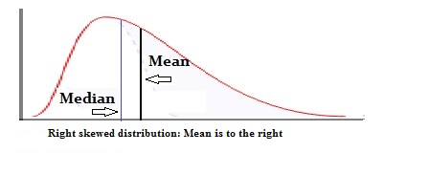
A right-skewed distribution will have the mean to the right of the median.

Slide 12
Question
Read the item and then answer the questions that follow.
A psychologist investigating the investment model of relationships, devised a self-report Investment Scale for use with a group of 100 female participants. The scale gave an investment score for each participant on a scale of 0–20, with 0 representing no investment in relationships and 20 representing extreme investment in relationships.
The psychologist calculated measures of central tendency for the investment
scores. He found that the mean investment score was 8.6, the median investment score was 9.5 and the mode investment score was 13.
Sketch a graph to show the most likely distribution curve for the investment scores in this study. Label the axes of your graph and mark on it the positions of the mean, median and mode. [3 marks]
What sort of distribution does your graph show? (1 mark)

Slide 13
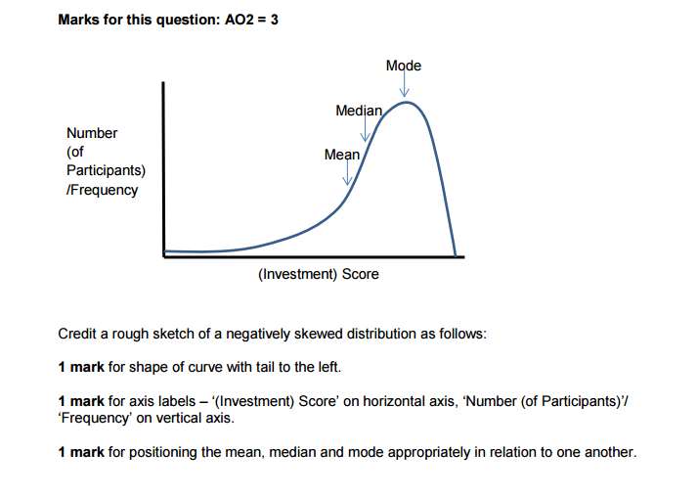
Negatively

Slide 14
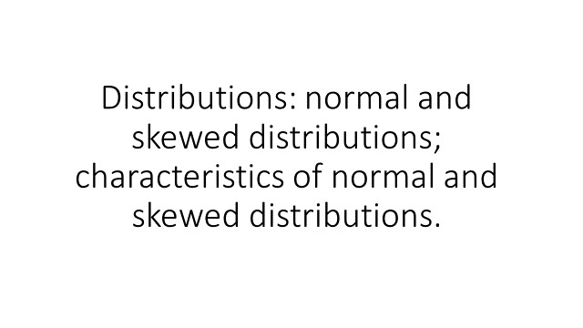
Link explanantion

