Slide 1
Correlation
Analysis and interpretation of correlation, including correlation coefficients

Slide 2
Correlation Coefficient
A statistic that quantifies a relation between two variables
Can be either positive or negative
Falls between -1.00 and 1.00
The value of the number (not the sign) indicates the strength of the relation

Slide 3
Positive Correlation
Association between variables such that high scores on one variable tend to have high scores on the other variable
  A direct relation between the variables

Slide 4
Negative Correlation
Association between variables such that high scores on one variable tend to have low scores on the other variable
  An inverse relation between the variables

Slide 5
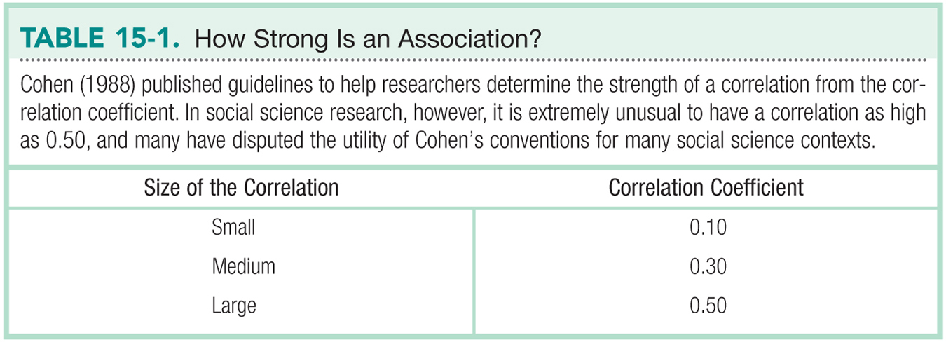

Slide 6
Correlation coefficient
In statistics, the correlation coefficient r measures the strength and direction of a linear relationship between two variables on a scatterplot. The value of r is always between +1 and –1. To interpret its value, see which of the following values your correlation r is closest to:
Exactly –1. A perfect downhill (negative) linear relationship
–0.70. A strong downhill (negative) linear relationship
–0.50. A moderate downhill (negative) relationship
–0.30. A weak downhill (negative) linear relationship
0. No linear relationship
+0.30. A weak uphill (positive) linear relationship
+0.50. A moderate uphill (positive) relationship
+0.70. A strong uphill (positive) linear relationship
Exactly +1. A perfect uphill (positive) linear relationship

Slide 7
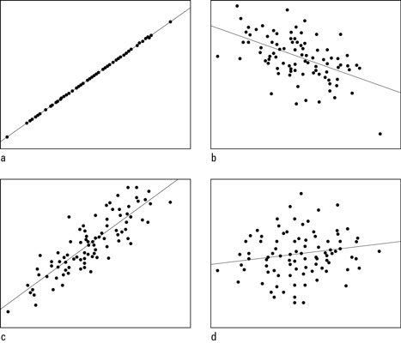
What do you think have a guess

Slide 8
Answers
Scatterplots with correlations of a) +1.00; b) –0.50; c) +0.85; and d) +0.15.

Slide 9
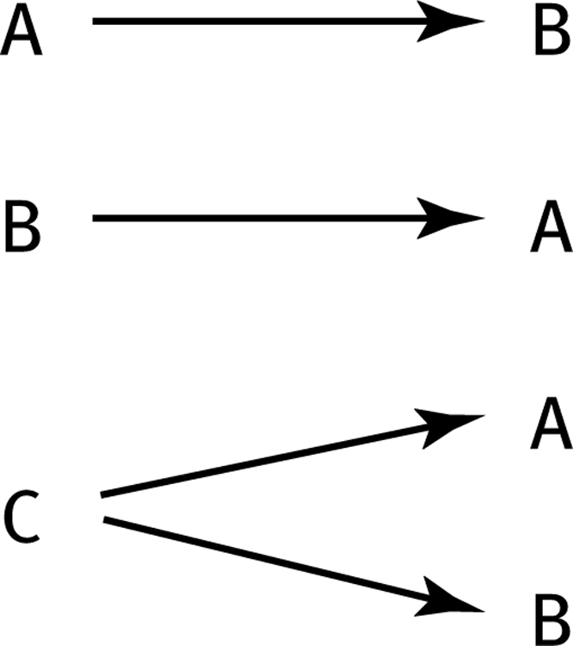
The Limitations of Correlation
Correlation is not causation.
  Invisible third variables
Three Possible Causal Explanations for a Correlation

Slide 10
The Limitations of Correlation, cont.
Restricted Range.
A sample of boys and girls who performed in the top 2% to 3% on standardized tests - a much smaller range than the full population from which the researchers could have drawn their sample.

Slide 11
The Limitations of Correlation, cont.
Restricted Range.
A sample of boys and girls who performed in the top 2% to 3% on standardized tests - a much smaller range than the full population from which the researchers could have drawn their sample.

Slide 12
The Limitations of Correlation, cont.
The effect of an outlier.
One individual who both studies and uses her cell phone more than any other individual in the sample changed the correlation from 0.14, a negative correlation, to 0.39, a much stronger and positive correlation!

Slide 13
The Pearson Correlation Coefficient
A statistic that quantifies a linear relation between two scale variables.
Symbolized by the italic letter r when it is a statistic based on sample data.
Symbolized by the italic letter p “rho” when it is a population parameter.

Slide 14
Correlation and Psychometrics
Psychometrics is used in the development of tests and measures.
Psychometricians use correlation to examine two important aspects of the development of measures—reliability and validity.

Slide 15

Reliability
A reliable measure is one that is consistent.
One particular type of reliability is test–retest reliability.
Correlation is used by psychometricians to help professional sports teams assess the reliability of athletic performance, such as how fast a pitcher can throw a baseball.

Slide 16
Validity
A valid measure is one that measures what it was designed or intended to measure.
Correlation is used to calculate validity, often by correlating a new measure with existing measures known to assess the variable of interest.

Slide 17

Correlation can also be used to establish the validity of a personality test.
Establishing validity is usually much more difficult than establishing reliability.
Most magazines and newspapers never examine the psychometric properties of the quizzes that they publish.

Slide 18
Partial Correlation
A technique that quantifies the degree of association between two variables after statistically removing the association of a third variable with both of those two variables.
Allows us to quantify the relation between two variables, controlling for the correlation of each of these variables with a third related variable.

Slide 19
We can assess the correlation between number of absences and exam grade, over and above the correlation of percentage of completed homework assignments with these variables.

