Slide 1
Factors affecting attraction in romantic relationships:
self-disclosure;
physical attractiveness,
  including the matching hypothesis;
    filter theory,
      Proximity
      including social demography,
      similarity in attitudes and
      complementarity.

Slide 2
self-disclosure
We reveal more to people we like.
We like people who reveal more about themselves
Happens when trust has been established.

Slide 3
Factors that effect
Appropriateness – lack of social skills. You have to be sensitive the social norms.
Attributions for disclosure (why they are doing it). Better the person being disclosed to feels that it is intimate and not something everybody knows.
Gender differences: less appropriate by males but this may make females feel more special. Males may be awkward and feel threatened if female discloses too much as they are not used to it.

Slide 4
Klienke
Found that if the perception of the self disclosure was selective then the individuals were more attractive.
Wortman et al. Found similar results and that those being disclosed to felt trusted and admired and so rated the person disclosing higher.
More research on page 73 and 74

Slide 5
Evaluation
Friendship and romantic relationships not distinguished.
Is this the only thing – probably not.
Personality may come into this (Individual differences) some people like to know more about their partners or are better at giving out information. The opposite can also be true.

Slide 6
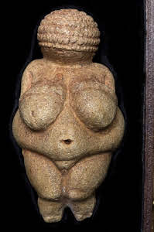
Physical attractiveness
More important to males than females. Why?
The Halo effect - your attractive therefore you are trustworthy optimistic and sociable.
As discussed previously. Women may want a muscular man but they may also choose an older man as they have proven resource richness. Men want physical indicators of fertility eg: healthy, youthful good hair?
However this has changed over time, cultures, age.

Slide 7
The matching Hypothesis
Perceived equity.
If they are much more attractive they will terminate the relationship.
Attraction the matching phenomenon

Slide 8
Filter Theory
Kerckhoff and Davis (1962)
Model proposes that relationships develop through different filters - different factors are important at different times
Potential partners are filtered so that the ‘field of availables’ is narrowed down to a relatively small field of desirables - those we consider potential partners.

Slide 9
Proximity
Proximity is the most obvious filter:
Festinger et al. (1950) friendship patterns among retired, married servicemen and their wives living in two quite different halls of residence while studying at Massachusetts Institute of Technology were observed. Two findings soon became apparent:
• people became friendly with those who were in neighbouring rooms, and those friendships were deepest
• people living in the more central positions, nearest to the communal rooms and stairwells, had a wider circle of friends than those living furthest down the hall.

Slide 10
Similarity
Social and/or cultural similarity is also thought to narrow down our ‘field of eligibles’.
Newcomb (1961)
Randomly allocated a group of 17 male students to share rooms in a boarding house while they were studying at Michigan University. At the end of the year 58% of those paired with room-mate with similar attitudes formed friendships as opposed to friendships between 25% of those with dissimilar room-mates.

Slide 11
Complementary
Potential partners meet each others needs, especially emotional ones.
Seen as the most important towards a long term relationship.

Slide 12
Physical attractiveness
Walster and Berscheid's 'computer dance' experiment
A computer dance was advertised during freshers week at a college.
  A total of 752 males and females attended for just $1.00.
  Each student was independently assessed by judges for attractiveness when they signed up.
  Students were then randomly paired by a computer (except no man went with a taller woman).
  During the dance and again 2 days later students completed questionnaires about the dance and their dates.
Result
That physical attractiveness was the most important factor in liking.
The most physically attractive students were liked more by their dance partners.
Physical attractiveness was a good indicator of whether they would see each other again.
Six months later when asked if the participants had seen their date again they found that the participants were more likely to have dated if they were of similar attractiveness.

Slide 13
Evaluation
Kerchkoff & Davis (1962) who tested model using a longitudinal study of student couples together for more or less than 18 months - pp’s asked to report attitude similarity and personality traits with their partners.
Results
Attitude similarity was most important factor in first 18 months of relationship - after this psychological and emotional compatibility more important.
Spreecher (1998) who found Couples matched in physical attractiveness and social background more likely to develop long term relationship
Gruber-Badini et al (1995) who found that couples similar in age and educational background at start of relationship more likely to stay together

Slide 14
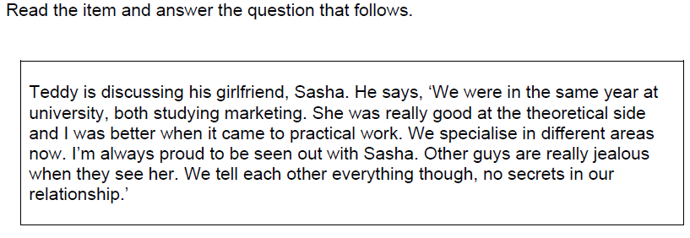
Essay Questions with STEMS
07 Discuss factors affecting attraction in romantic relationships. Refer to Teddy’s comments in your answer. [16 marks]

Slide 15

Example Question 1
Question 1: Denola and Chris are studying Psychology in Year 13 and are both very attracted to Mila. Mila is very sensible and while she finds Chris more attractive, she has just found out that Denola works in Waitrose, earning £7.27 and receiving 12% discount on groceries and 25% discount in John Lewis. She also learns that Chris doesn’t have a job. Naturally, she decides to start dating Denola…
Use your knowledge of evolutionary explanations for partner preferences, explain why Mila starts dating Denola and not Chris. (16 marks).

Slide 16
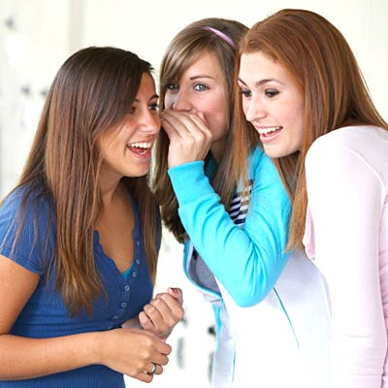
Example Question 3
Question 3: Ben and Harriet are on their very first date. Harriet decides to tell Ben about all of her previous partners and doesn’t let Ben say a word all evening.
Ben, who is naturally reserved, decides not to go into his past relationships and reveals very little. The next day Harriet is gossiping in Mr Sparks’s tutorial (as per usual) about her date. She said that the date didn’t go well and she felt uncomfortable with Ben and probably won’t see him again.
Referring to Harriet and Ben, discuss the role of self-disclosure in attraction. (16 marks)

Slide 17
Question on disclosure?
Appropriateness – Is it appropriate on the first date.
Attributions – Why are they disclosing
Gender differences – Women disclose more than men.
Content – The more intimate usually the better but too intimate may violate social norms.

Slide 18
Mapping Issues & Debates in Year 2
Relationships | Which Issue and Debate? | Why?
09.1 Evolutionary explanations | Biological Determinism Social Sensitivity | Views partner preferences as being due to genetic influences (biological determinism). Socially sensitive as can be see to justify behaviours such as male promiscuity and even rape.
09.2 Attraction | Nomothetic Approach | Filter theory seeks to formulate general laws of behaviour by suggesting that we all use a series of filters to narrow down the 'field of availables'.
09.3 Romantic relationships | Cultural Bias - Ethnocentrism | Most research into romantic relationships has been conducted in Western societies. Some research has suggested that equity is not as important in non-Western cultures.
09.4 Duck's phase model | Social Sensitivity | Carrying out research into relationship breakdown can potentially be intrusive and distressing for partipants.
09.6 Parasocial relationships | Nomothetic Approach | Use of the Celebrity Attitude scale to identify levels of parasocial relationship is an example of a nomothetic, quantitative approach.

Slide 19
Nomothetic Idiographic Debate
The term “nomothetic” comes from the Greek word “nomos” meaning “law”. Psychologists who adopt this approach are mainly concerned with studying what we share with others. That is to say in establishing laws or generalizations.
The term “idiographic” comes from the Greek word “idios” meaning “own” or “private”. Psychologists interested in this aspect of experience want to discover what makes each of us unique.
Despite the fact that an important aspect of our uniqueness is our genes (i.e. it comes from biology) the distinction between the nomothetic and the idiographic is often equated with two types of science – the natural sciences concerned with discovering laws of nature and the social sciences with individual meanings.

Slide 20
We can see that the difference between a nomothetic and an idiographic approach is not just a question of what the psychologist wants to discover but also of the methods used. Experiments. correlation, psychometric testing and other quantitative methods are favoured from a nomothetic point of view. Case studies, informal interviews, unstructured observation and other qualitative methods are idiographic.
There are also broad differences between theoretical perspectives. Behaviorist, cognitive and biological psychologists tend to focus on discovering laws or establishing generalizations. The humanists are interested in the individual. As in so many other debates psychoanalysis is difficult to pin down. Thus it could be seen as nomothetic if one were to concentrate on Freud’s view of the psychic apparatus common to us all (id, ego, superego). On the other hand each patient represents a new challenge for therapy with a configuration of defense mechanisms that is all their own and an illness that derives from unique childhood experiences.

Slide 21
Recap
The evolutionary explanations for partner preferences, including the relationship between sexual selection and human reproductive behaviour.
Factors affecting attraction in romantic relationships: self-disclosure; physical attractiveness, including the matching hypothesis; filter theory, including social demography, similarity in attitudes and complementarity.

Slide 22
