Slide 1
Theories of romantic relationships
social exchange theory
equity theory
Rusbult’s investment model of commitment, satisfaction, comparison with alternatives and investment.
Duck’s phase model of relationship breakdown:
  intra-psychic,
  dyadic,
  social
  grave dressing phases.

Slide 2
Social exchange theory (SET)
Maximise profits and minimise costs.
SET is an economic theory. A theory that has a mutual exchange of rewards between partners, like friendship and sex and the cost of maintaining the relationship such as freedoms given up. A person assesses their rewards by making two comparisons.
The comparison level: Rewards – Cost = Profit
The comparison level for alternative relationships. Rewards and costs are compared to the rewards and costs of a possible alternative relationships.
Relationships is maintained if rewards exceed costs and the profit level is not exceeded by possible alternative relationships.

Slide 3
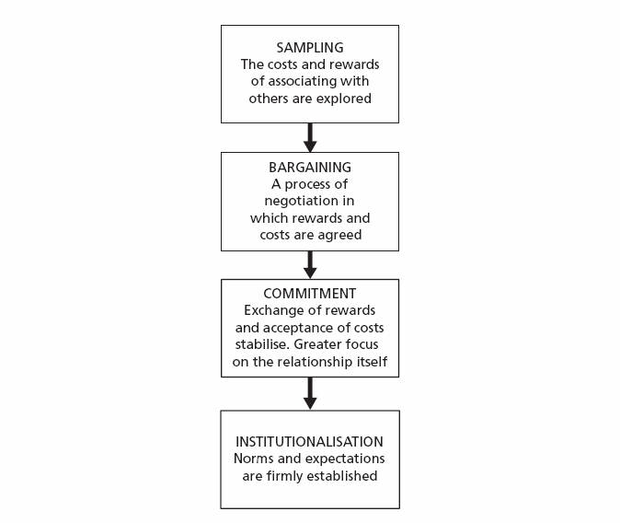
John Thibaut and Harold Kelley (1959)
Proposal of a four stage model

Slide 4
Over to you note research page 81.

Slide 5
Evaluation:P82
Positive:
Negative:

Slide 6
Equity theory
Not equality but fairness and this can differ dependent on the individual.
Little video

Slide 7
Maintenance of relationships: This occurs through balance and stability. If this perception of equity is unbalanced this will lead to dissatisfaction and possible ending of the relationship – this can be saved by adjustments.

Slide 8
Walster et al
4 principles of equity
Principle | Description
Profit | Rewards maximised and costs minimised
Distribution | Trade-offs leading to fairness
Dissatisfaction | The greater the perceived unfairness the greater the dissatisfaction.
Realignment | Restoration of equity will lead to maintenance continueing.

Slide 9
Research
Argyle: People do not feel in terms of rewards and costs unless dissatisfied implying the equity theory if seen in a conscious manner is not a good explanation of romantic relationship maintenance
Yum et al (2009) Looked at romantic relationships in 6 different cultures and found that like equity theory maintenance strategies differed. So a cross cultural theory.

Slide 10
Evaluation P84

Slide 11
Rusbult’s investment model of commitment, satisfaction, comparison with alternatives and investment.
Builds upon the Social Exchange Theory discussed above and proposes that three factors contribute to the level of commitment in a relationship.
  Satisfaction
  Comparison with alternatives
  Investment
They are the extent to which a partner feels a relationship is worthwhile for them when comparing other possible relationships and their investment against the rewards offered by the pairing. The third factor is an addition to the model, investment size, which explains why relationships do not all breakdown when the CL (The comparison level in a relationship is a judgement of how much profit an individual is receiving (benefits minus costs)) or Comparison Level alternative are low.
Link to video

Slide 12
Investment in relationships
Investment in relationships can be measured as a combination of intrinsic and extrinsic investments which have been made over the course of the relationship.
Intrinsic (inherent) investments are those which have been added by a single partner such as money towards a date or a gift, time spent with the person and any self-disclosures which have been made.
Extrinsic (external) investments are those which have been created or developed over the course of the relationship which are shared by both partners, such as large purchases (a house or car) or even children.

Slide 13
Two Variable linked to Commitment
Equity – fairness
Social Support – family and friends approval.
Your turn
Research and evaluation. P85

Slide 16
Ducks theory of relationship dissolution
Duck Proposed three broad categories why relationships breakup:
Pre-existing doom – Incompatibility and failure are almost predestined
Mechanical Failure – Two suitable people of goodwill and good nature grow apart and find they cannot live together (The most common cause)
Sudden Death – The discovery of betrayal or infidelity leads to immediate termination

Slide 17
Other factors that could also contribute were:
Predisposing personal factors – for example an individuals bad habits or emotional instabilities
Precipitating factors – for example exterior influences, such as love rivals, incompatible working hours, lack of relationship direction and attributions of blame; such as perceiving that someone else is to blame.
Lack of skills – for example being sexually inexperienced
Lack of motivation – for example perceiving inequity
Lack of maintenance – for example, spending too much time apart.

Slide 18
The four stages of break up are:
Intrapsychic – One partner privately perceives dissatisfaction with the relationship.
Dyadic – The dissatisfaction is discussed. If is not resolved, it moves to the next stage
Social – the breakdown is made public. There is negotiation over assets, children, finances and so on with wider families and friends becoming involved.
Grave dressing – A post-relationship view of the breakup is established; protecting self-esteem and rebuilding life towards new relationships.

Slide 19
Describe and evaluate Duck's phase model of relationship breakdown
Use your notes.

Slide 20
From The book P89
Strengthen your learning.

Slide 21
We have covered:
The evolutionary explanations for partner preferences, including the relationship between sexual
selection and human reproductive behaviour.
Factors affecting attraction in romantic relationships: self-disclosure; physical attractiveness,
including the matching hypothesis; filter theory, including social demography, similarity in attitudes
and complementarity.
Theories of romantic relationships: social exchange theory, equity theory and Rusbult’s investment model of commitment, satisfaction, comparison with alternatives and investment. Duck’s phase model of relationship breakdown: intra-psychic, dyadic, social and grave dressing phases.
Virtual relationships in social media: self-disclosure in virtual relationships; effects of absence of
gating on the nature of virtual relationships.
Parasocial relationships: levels of parasocial relationships, the absorption addiction model and the
attachment theory explanation.

