Slide 1
Relationships

Slide 2
The evolutionary explanations for partner preferences, including the relationship between sexual
selection and human reproductive behaviour.
Factors affecting attraction in romantic relationships: self-disclosure; physical attractiveness,
including the matching hypothesis; filter theory, including social demography, similarity in attitudes
and complementarity.
Theories of romantic relationships: social exchange theory, equity theory and Rusbult’s investment model of commitment, satisfaction, comparison with alternatives and investment. Duck’s phase model of relationship breakdown: intra-psychic, dyadic, social and grave dressing phases.
Virtual relationships in social media: self-disclosure in virtual relationships; effects of absence of
gating on the nature of virtual relationships.
Parasocial relationships: levels of parasocial relationships, the absorption addiction model and the
attachment theory explanation.

Slide 3
Why do we have relationships?

Slide 4
How do relationships form?

Slide 5
Why do relationships break down?

Slide 6

Evolution –survival of the fittest!
50% genes inherited from each parent.
Mutations. Positive or negative.
Think birds some have developed plumage to attract a mate that gives them a reproductive advantage even though they may well be easier to spot by predators.
So evolution shapes human reproductive behaviour.
This means how our sexual selection works.
Lets have a go

Slide 7
Evolution approach – Socio-biological explanation
Sexual dimorphism:
the differences in appearance between males and females of the same species, such as in colour, shape, size, and structure, that are caused by the inheritance of one or the other sexual pattern in the genetic material.
Why: Gives an adaptive advantage to increase chances of survival into adulthood and sexual maturity and the ability to pass on your genes. E.g. Being muscular increases chance of getting a mate then over time this characteristic will be enhanced.

Slide 8
Anisogamy
Reproductive success means that you are producing healthy offspring who survive to sexual maturity.
Male and female reproductive behaviour will be due to the difference between the nature of gametes (sperm and eggs) that are produced. - Anisogamy
1 male ejaculation = population of Britain X 2
So what behaviour should males do?

Slide 9
So what. Men
If males can produce lots of sperm with little cost to reproductive potential then they are likely to be polygamists. (lots of partners).
You are not sure it is yours! DNA
So the best male strategy is to have lots of sex and lots of partners. Also choosing partners who are likely to be fertile – good child bearing hips, healthy, youthful.

Slide 10
Courtship rituals
Allows males to display genetic potential
Video

Slide 11
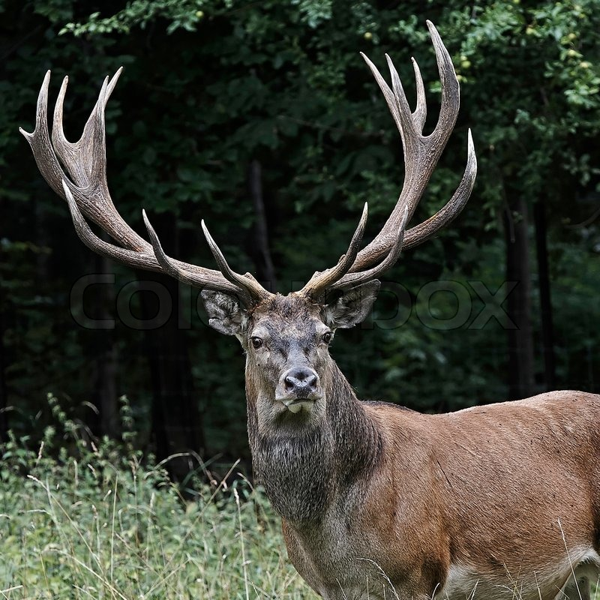
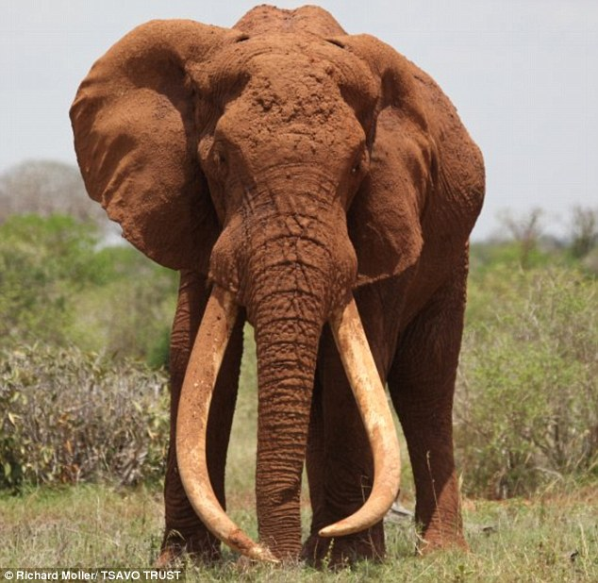
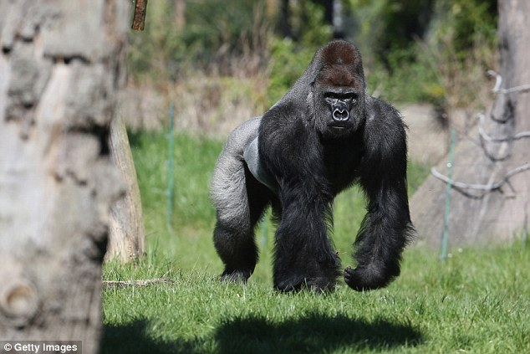

Size
Demonstrate strength against other males. Also look at size of weaponry.

Slide 12
Mate guarding
Fear of being cuckolded (brining up another's child.
Buss
Males fearful of partners being sexually unfaithful.
Females worry about emotional unfaithfulness as they want the resources.

Slide 13
Sneak copulation
Males want to produce as much as possible so mate when given the opportunity.
Females get mix of genetic code and get to mate with stud!
I.e.: resource rich husband and pregnant from hunky genetically fit mate
Research is mixed about this. I wonder why?

Slide 14
Females
Produce few relatively large eggs which represent a sizeable reproductive investment. However sure of the DNA!
They have a short span 25 years of fertility so only 300 opportunities to produce offspring.
Therefore females are more picky and will make use of courtship rituals so they can get the best male who will provide protections and resources to her and her offspring.

Slide 15
Sexy sons hypothesis
Chose attractive males as their sons will be attractive and so pass on the genes.

Slide 16
Handicap hypothesis Zahavi
Females like to see that males can overcome handicap. Therefor they are genetically superior. Can explain why females are attracted to people who drink or take drugs as they can “handle it” therefore have genetic superiority.

Slide 17
Courtship
Health, Strength and ability to provide resources.
Lets go out for the night. I will buy you dinner and then we will dance the night away and I will carry you home!

Slide 18
Davis
Content analysis? Of personal adverts. Females offer beauty and youth and males offer wealth and resources.
Study reproduced by Dumbar

Slide 19
Read Page 68 and 69
Make your own notes on research.

Slide 20
To conclude then:

Slide 21
Anisogamy
Anisogamy means two sex cells (or gametes) that are different coming together to reproduce. Men have sperm cells, which are able to reproduce quickly with little energy expenditure and once they start being produced they do not usually stop until the man dies.
Female gametes (eggs or ova) are, in contrast, much less plentiful; they are released in a limited time frame (between puberty and menopause) and require much more energy to produce. This difference (anisogamy) means that men and women use different strategies when choosing their partners.

Slide 22
Inter-sexual Selection
Females lose more resources than men if they choose a sub-standard partner, so are pickier about who they select. They are more likely to pick a partner who is genetically fit and willing to offer the maximum resources to raise their offspring (a man who will remain by her side as the child grows to protect them both and potentially provide more children).
If they have made a good choice, then their offspring will inherit the positive features of their father and are therefore also more likely to be chosen by women or men in the next generation.

Slide 23
Intra-sexual Selection
Whilst females prefer quality over quantity, anisogamy suggests that men’s best evolutionary strategy is to have as many partners as possible.
To succeed, men must compete with other males to present themselves as the most attractive mate, encouraging features such as muscles which indicate to the opposite sex an ability to protect both them and their offspring.

Slide 24
Is that it then about relationships?

