Slide 1
Reducing Addiction
drug therapy
behavioural interventions including aversion therapy and covert sensitisation.
cognitive behaviour therapy
The application of the following theories of behaviour change to addictive behaviour
the theory of planned behaviour
Prochaska’s six-stage model of behaviour change

Slide 2
Drug therapy
Heroine to methadone – gradually reduced. Less withdrawal symptoms therefore less likely to relapse.
Alcohol – There is no drug
  However benzodiazepine mimic the effect of the sedative effects of alcohol
  Antabuse – makes you feel ill when you have alcohol (aversion therapy) the release of acetic acid is inhibited.
Nicotine - Slow release and less eg: patches and gum. So lessens effect of withdrawal

Slide 3
Evaluation
Malcolm et al found no difference with those who used benzodiazepine and those who used a placebo when giving up alcohol.
Mcellan – found that when methadone was paired with a psychotherapy the groups faired much better.
Fiore et al (meta analysis) Nicotine patch compared with placebo twice as likely to give up.

Slide 4
Evaluation
What is the problem with drugs?
What is best – a combined approach.
What is the problem with a talking therapy? And therefore a combined approach.
Moving to methadone removes the need to hang around a criminal element and therefore improves chances of beating the addiction.

Slide 5
Behavioural Intervention
Aversion Therapy (classical conditioning)
See diagram on page 419
Aversion therapy is used for alcohol addictions. The patient would either be given an emetic after consuming alcohol, or a drug such as disulfiram. The emetic causes vomiting, whilst the disulfiram (Antabuse) creates the immediate feeling of a hangover. Either way, the patient associates alcohol with these unpleasant consequences, and so their addiction undergoes extinction (in classical conditioning terms). The alcohol is the unconditioned stimulus, whilst the drug is the neutral stimulus.

Slide 6
Howard found it worked for alcoholics
Curtis tried with nicotine addiction but although both groups showed some success there was no significant difference between groups.

Slide 7
Evaluation
Ethics. Harm Physiological and mental harm.
  Essentially self-inflicting pain and nausea may be considered as breaching the BPS ethical guidelines of a participant’s right to be protected both psychologically and physically.
  Such extremely unpleasant consequences may demotivate others from engaging or starting these therapies, thus doing little for their motivation in tackling their addiction.
Individual differences. Does not work with everybody famously did not work for George Best.

Slide 8
Covert Sensitisation
Stage 1: taught to relax
Stage 2: Aversion therapy through imagination. (verbal aversion therapy).
  Imagine the bad consequences of their actions
  They (alcoholics) are asked to imagine being sick over themselves in public. Ie The therapist wants to evoke a negative feeling towards drinking the greater the feeling the better.

Slide 9
Evidence
Ashen and Donner 40% abstinent after 6 months whereas non in the control group.
Look at the evaluation on page 422

Slide 10
Cognitive Behavioural Therapy
Your go.
What do you think are the theories that these therapies are based upon.

Slide 11
CBT assumes that faulty cognitive processing and cognitive biases are the key to a patient’s addiction, and so must be challenged. This is possible through functional analysis (where the key risk factors for triggering addictive behaviours are identified) and skills acquisition (which acts as an alternative coping mechanism for the patients, apart from the addictive source).
Functional analysis aims to identify the situations and stimuli which trigger the start of carrying out addictive behaviours, as well as considering the emotions felt before, during and after such behaviours. For example, an alcoholic may admit that social situations in which there are many strangers, triggers their social anxiety and so leads them to drinking excessively in order to ‘loosen up’. The key to this interaction is the quality of the patient-therapist relationship, which must be warm enough to build rapport whilst still maintaining a psychological distance so that the therapist can be firm in their own beliefs. The therapist will identify and challenge irrational beliefs or cognitive biases.
Functional analysis is an ongoing process and is not restricted to the beginning of therapy, but is often revisited in the case of relapse.

Slide 12
Skills.
See page 422
The key to cognitive restructuring is the therapist explaining the irrationality of the patient’s cognitive biases and offering other rational/logical alternatives. This may also be educational - in the example of a recovering alcoholic who drinks excessively to deal with their stress, the therapist may point out that alcohol only aggravates the body, weakening the immune system and making the patient more vulnerable to illness, which would only increase their stress further.

Slide 13
Specific skills involves the therapist and the patient making links between the patient’s life problems and their current disorder, thus giving CBT the description of a ‘broad-spectrum’ treatment for this awareness. Anger management training, such as identifying the emotions which act as a precursor for aggression (Novaco et al), as well as assertiveness training (increasing social communication skills and realising that violence is not the single best way to resolve a conflict) are both examples.

Slide 14
Social skill development involves the therapist teaching the patient methods in which to ignore or reduce the impact of triggering stimuli. For example, in the case of a drug addict, the therapist may suggest that the patient avoids situations in which drugs are frequently used (e.g. parties) and come up with ‘excuses’ that could be used when being offered drugs (e.g. a lack of funds). The therapist will model such methods which the patient will copy, through role play and a ‘directive’ therapy.

Slide 15
The application of the following theories of behaviour change to addictive behaviour the theory of planned behaviour
A cognitive theory first proposed by Azjen and Fishbein (1975)

Slide 16
Assumption
A person’s decision to perform a particular behaviour (such as stopping smoking) can be predicted by their intentions. According to the theory, intentions are determined by three variables:

Slide 17
These are:
1. Personal Attitude (Personal perspective if you like)
This is our personal attitude towards the target behaviour. It is the sum of all our knowledge, attitudes, prejudices etc. that we think of when we consider the behaviour. For example, our individual attitude to alcohol might include, pleasurable, relaxing, nice taste, makes us feel good, makes us brave, can cause hangovers, makes us aggressive, too many calories etc. Gambling is an escape from boredom and might make me rich but it’s costing too much money and my marriage. We weigh up the good and the bad and form an overall impression.
2. Subjective norms
Considers how we view the ideas of other people about the target behaviour. For example the attitude of family and friends to alcohol. We consider whether they approve of alcohol, their drinking habits, their past experiences etc. The closer the friends the greater the influence of their attitudes upon us. The client might also be asked about how friends and family would feel if they knew the extent of their gambling, drinking behaviour. Crucially it is not the actual thoughts of their friends and family that is measured but the client’s perception of those thoughts.
3. Perceived Behavioural Control
The extent to which we believe we can exert control over our behaviour. This includes a combination of our own ability or self-efficacy and external factors such as the resources and support we will have at our disposal. The theory believes that this perception of behavioural control acts on either the intention or directly on the behaviour itself. This has two effects:
The more control we believe we have over our behaviour, the stronger our intention to perform the behaviour.
The person with the higher perceived level of control will try harder and longer to succeed.

Slide 18
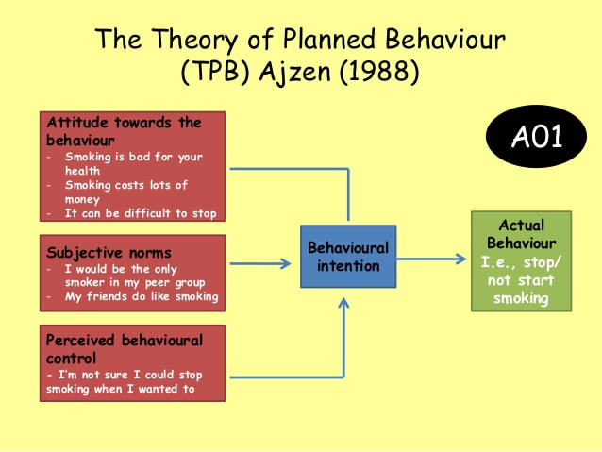

Slide 19
AO3
At present this is the most widely used and applied model of social cognition used in health psychology. This would suggest it has a fair amount in its favour.
Hagger et al (2011) found that the model did exactly what it proposes. All three of the components correlated with alcoholics’ intentions to limit or stop their drinking. Crucially and unusually they also reported that those intentions were then reflected in the eventual behaviour and could predict the approximate number of units consumed. However, there were two provisos: The length of time between intentions and the behaviour was short and the intentions did not predict all drink-related behaviours. In this case it could predict the number of units but not binge-drinking behaviour. Why might this be the case? – intentions when drunk!

Slide 21
The application of the following theories of behaviour change to addictive behaviour
Prochaska’s six-stage model of behaviour change
PCPAMT
Prochaska and DiClemente (1983) noticed that the behaviour and intentions of nicotine-dependent smokers went through a series of changes as they were attempting to quit. The model sees the process of quitting as flexible and complex. Stages may be skipped and others re-visited so it’s not actually a true-stage theory (where stages are not revisited once a person moves on). The process is cyclical.
In practical terms it:
Considers how ready smokers are to quit
Realises that interventions will vary depending on the stage the client is at.

Slide 22
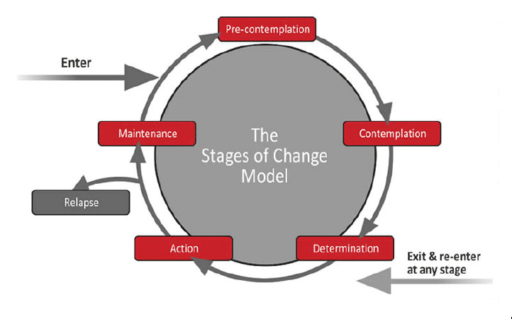

Slide 23
P428
Stage and Description | Example of Thinking
Precontemplation (ignorance is bliss) People in the precontemplation stage do not intend to take action in the foreseeable future, usually measured as the next six months. They could be in denial and refusing to accept that there’s a problem or just not motivated to change. Many unsuccessful attempts at change can lead to demoralization about the ability to change. The most useful intervention would be helping them to consider change. | My smoking is not a problem so why should I want to quit?
Contemplation (sitting on the fence) Contemplation is the stage in which people intend to change in the next six months. They are more aware of the pros of changing, but are also acutely aware of the cons. This weighting between the costs and benefits of changing can produce profound ambivalence that can cause people to remain in this stage for long periods of time. Drug interventions would not be helpful at this stage | I know my smoking is a problem and I want to stop but haven’t got any plans yet.
Preparation (I’m ready for this) Preparation is the stage in which people intend to take action in the immediate future, usually measured as the next month. Typically, they have already taken some significant action in the past year. These individuals need a plan of action, such as joining a gym, consulting a counsellor or talking to their GP. | I am making plans and changing things in preparation for quitting.
Action (Let’s doooooo it) Action is the stage in which people have made specific overt modifications in their lifestyles within the past six months. Because action is observable, the overall process of behavior change often has been equated with action, for example, reduction in the number of cigarettes or switching to low-tar and low-nicotine cigarettes were formerly considered acceptable actions. Intervention now involves coping skills needed to maintain change. | I have quit!
Maintenance Maintenance is the stage in which people have made specific modifications in their lifestyles and are working to prevent relapse. While in the Maintenance stage, people are less tempted to relapse and grow increasingly more confident that they can continue their changes. Based on self-efficacy data, researchers have estimated that Maintenance lasts from six months to about five years. Helping clients apply coping skills is the best intervention. | I am continuing not to smoke but I sometimes miss it.
Termination Abstinence is now automatic. Stressful events and loneliness are no longer a likely to trigger lapses or relapse. This final stage might not be possible for all addicts to achieve. For many addicts maintaining maintenance and seeing the occasional lapse as inevitable is most realistic. For those reaching termination further intervention is no longer needed. | I no longer smoke and no longer miss smoking.
PCPAMT

