Slide 1
Personality as a risk factor
Eysenck (1967) proposed that there was an addictive personality type which was passed on genetically. He identified 3 types of personality
Extroverted
Neuroticism
Psychoticism
He found that those who were neurotic or psychotic were more at risk of becoming addicted

Slide 2
The following table describes the traits that are associated with the three temperaments in Eysenck's model of personality:
Psychoticism Extraversion Neuroticism
Aggressive Sociable Anxious
Assertive Irresponsible Depressed
Egocentric Dominant Guilt Feelings
Unsympathetic Lack of reflection Low self-esteem
Manipulative Sensation-seeking Tense
Achievement-oriented Impulsive Moody
Dogmatic Risk-taking Hypochondriac
Masculine Expressive Lack of autonomy
Tough-minded Active Obsessive

Slide 3
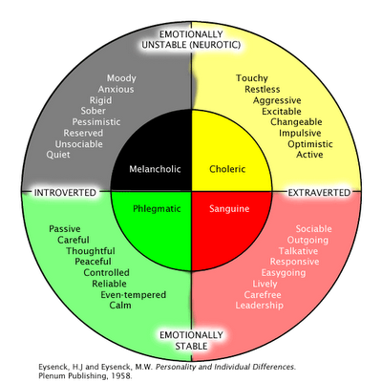

Slide 4
Evidence
Other research has found a strong positive correlation between addiction and high scores on Neurotic and Psychoticism
Rounsaville et al (1998) found a strong link between anti-social personality disorder and alcoholism
Slutsky (1998) strong link between alcoholism and conduct disorder
This all seems to suggest relationship between personality and addiction

Slide 5
However………..?
Cause and effect ……….?
These are all correlational studies so we need to be cautious
Could the changes in behaviour cause the personality change?
Could dopamine sensitivity be inherited ?

