Slide 1
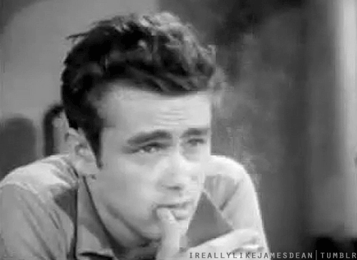
Family and addiction
Smoking and SLT – smoke and you get friends (reward). Do not smoke and you do not have any friends.
Smoking and expectancy: See a rock star smoke and he is cool and so you will be cool if you smoke. My elder brother is cool and smokes therefor….
Page 403 for research.

Slide 2
Peers are very similar.
They can create access and opportunity.
Or the opposite.
Extremely difficult to measure.

