Slide 1
Psychology A
AQA

Slide 2
Unit 1 – PSYA1
Cognitive Psychology, Developmental Psychology and Research Methods

Slide 3
Models of memory
The multi-store model, including the concepts of encoding, capacity and duration. Strengths and limitations of the model
  Atkinson and Shiffrin (1968).
The working memory model, including its strengths and limitations
  Baddeley and Hitch (1974).

Slide 4
Terms
Term | Definition
Encoding | Coding information so it can be stored in your memory, it makes words have meanings.
Storage | This happens as a result of encoding.
Retrieval | Recovering stored information from the memory system.
Capacity | The amount of information (usually pieces) a memory store can hold.
Duration | The amount of time information remains in a memory store.
Rehearsal | Repeating information over and over again mentally.
Acoustic | How information sounds if it is spoken/ thought aloud.
Semantic | Information with meaning.

Slide 5

multi-store model

Slide 6
Evaluation
Strength- Research for short term memory supports that there is two stores.
Strength- Primacy (remembering the first words in a list as they are transferred to LTM) and Recency (remembering the last words in a list as they are still in STM) effect shows that there are two stores.
Strength- The case studies of HM + Wearing prove there are two stores.
Strength- Neuropsychology: PET and MRI scans of patients such as HM and KF show that there are centres for STM and LTM

Slide 7
Weakness: Too simplistic
Neuropsychology: Hm damaged STM to the point he could not remember the name of the experimenter (Milner) but could remember how to do a task which showed that he had a type of working STM.

Slide 8
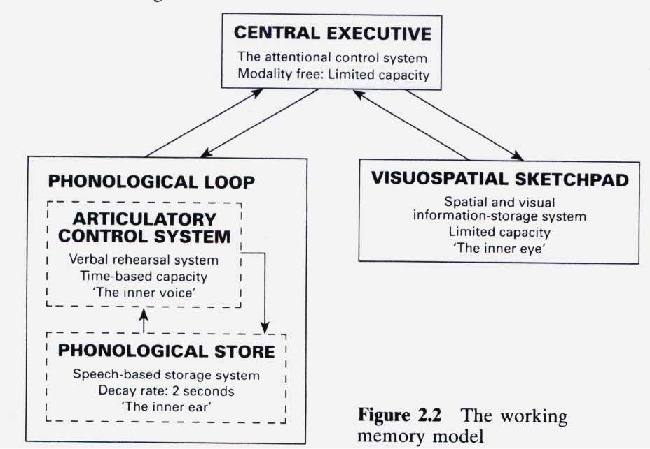
working memory model

Slide 9
Three components of the working memory model are the central executive, the phonological loop and the visuo-spatial sketchpad. 2 (a) Briefly outline each of these components.

Slide 10
The central executive has a supervisory function and controls the slave systems. It has
limited capacity but can process information from any sensory modality.
The phonological loop is a limited capacity, temporary storage system for holding verbal
information in a speech based form.
The visuo-spatial sketchpad is a limited capacity, temporary memory system for holding
visual and spatial information.
In each case 1 mark for a brief answer eg the visuo-spatial sketchpad holds visual and
spatial information. 2nd mark for accurate elaboration or an example of how it might be
used.
Within each component award a maximum of 1 mark for simply naming 1 or more parts
eg phonological store (inner ear), articulatory process (inner voice) in the phonological
loop, or inner scribe, visual cache in the visuo-spatial sketchpad.

Slide 11
Evaluation
Strength- much more detailed information about the processes involved in short term memory making it superior to the multi-store model in this respect.
Strength- highlights that memory is an active process rather than being passive.
Strength- it has a practical application to the real world- dyslexia can affect either the phonological loop or the visuospatial sketchpad and therefore strategies can be put into place to help with reading and writing.

Slide 12
Weakness- it only looks at short term memory- there is no explanation about how information is transferred between short and long term memory.
Weakness- it has highlighted the role of sensory memory but ignored most of the senses- e.g- touch, smell, taste
Weakness- very little is known about the decision making activities of the central executive.

Slide 13
Memory in everyday life
Eyewitness testimony (EWT). Factors affecting the accuracy of EWT, including misleading information, anxiety, age of witness
Improving accuracy of EWT, including the use of the cognitive interview
Strategies for memory improvement

Slide 14
EWT
Eyewitness testimony is the memory of an incident or event from someone who was actually there at the time.

Slide 15
Misleading information
Loftus and Palmer (1974)
Participants watch a video of a car accident.
Then they are asked the question to estimate the speed.
Smash
Barn

Slide 16
Question
Outline and evaluate research into the effects of misleading information on eyewitness testimony. 8

Slide 17
Answer
AO1 = 4 marks Outline of research into the effects of misleading information on EWT AO2 = 4 marks Evaluation of research into the effects of misleading information on EWT Students must select research which relates to misleading information, so research into weapon focus should not be credited.
Students are likely to refer to Loftus and Palmer‟s (1974) experiment where the verb in the critical question was changed (smashed, collided, bumped, hit or contacted.) Other relevant research would be Loftus and Palmer asking participants “Did you see any broken glass?” and Loftus et al‟s (1978) study using a red Datsun and Stop or Yield signs.
Research into anxiety and EWT is not relevant unless the student refers to leading questions such as Yuille and Cutshall where the witnesses to a real-life shooting appeared resistant to leading questions. Research relating to age in relation to misleading information could also be relevant. Eg Warren et al (2005) found children were more likely to be influenced by leading questions than adults. Credit any relevant research, studies and/or theories.
Evaluation might refer to lack of ecological validity in laboratory studies or lack of control in real life situations. Other methodological issues including sampling, possible replication and corroboration with other studies could be included. Ethical issues could be relevant as could practical applications of the research. Examiners are reminded this is an 8 mark question. Students can focus on one study in reasonable detail or more than one study in less detail.

Slide 18
Examiners report
There were many good answers to this question, mostly focused on the work of Loftus and her colleagues.
There were some inaccuracies with the figures, eg speeds of the cars and percentages, and who saw non-existent broken glass, etc, but on the whole answers demonstrated good knowledge. It was evident that students usually scored better marks where they outlined one or two research studies accurately and in reasonable detail, rather than when they outlined several studies less accurately.
A substantial number did not see the ‘outline and evaluate’ instruction. They tended to outline studies in great detail, but included no evaluation. Therefore, despite showing very good knowledge of the topic they were limited to four out of eight marks.
Evaluation was often effective where issues such as ecological validity, sampling issues or applications of the research were addressed. However, evaluation points were not always sustained or developed, meaning much of the commentary was basic, and some evaluation was more speculative where students referred to the trauma of watching a short video clip or looking at slides demonstrating two cars hitting each other. Comments about an independent groups design allowing individual differences to affect results were also marginal.

Slide 19
Anxiety
Inverted U theory (Deffenbacher, 1983)
Inverted U theory states that at low levels of anxiety cognitive performance (in this case memory accuracy) will be at a relatively low level, but as anxiety increases then so does cognitive performance until it reaches an optimal level after which any further increase in anxiety level leads to a rapid drop in cognitive performance.
Peters (1988) found that participants who received an inoculation showed impaired eyewitness identification and recollection of the appearance of the nurse who gave the injection
Weapons focus
Lab and real world

Slide 20
Age of witness
Kent & Yuille asked children to identify from a set of photographs a person they had seen earlier. They found that 9 year old children were far more likely than 14 year olds to identify someone from the photo set even when the target person was not present (want to please)
Cohen and Faulkner - they showed 70 year olds and 35 year olds a film of a kidnapping then presented them with misleading details before asking them to recall what happened in the film. They found that the 70 years olds were more likely to be mislead than the 35 years olds.

Slide 21
Question
Describe what research has shown about age of witness and eyewitness testimony. 4

Slide 22
Answer
There is a wide range of research that could be selected. Candidates might describe in some detail what one research study has shown, or describe more research studies in less detail. Some of the research is contradictory, so unsubstantiated statements such as “children’s memories are worse than adults” are unlikely to receive credit.
Candidates may refer to older and younger adults, eg Anastasi & Rhodes (2006) used participants aged 18 – 78 years. They found young and middle aged participants were more accurate at recognising photographs than older participants. Yarmey (1984) and Cohen and Faulkner (1988) found older people made more recall errors than younger people. However, Yarmey (1993) found no differences in the ability of older participants to recall physical characteristics of a young woman.
Reference to children as witnesses would also be relevant eg Warren et al (2005) found older children were more likely to be influenced by leading questions than adults.
Descriptions of procedures or evaluation of research are not credit-worthy.

Slide 23
Examiner’ comments
There were some impressive, well focussed responses where students produced evidence from a broad range of research findings. A few weak responses focussed more on procedure than what research has shown and some answers were so vague they could not receive credit.

Slide 24
Question
Outline one study that has investigated the effect of anxiety on eyewitness testimony 4

Slide 25
Answer
Candidates must select a study which clearly relates to both anxiety and eyewitness testimony. For full marks there must be some reference to what was done and what was found. In Loftus’s (1979) weapon focus experiment more participants correctly identified a person holding a pen (49%) than a person holding a knife covered in blood. Loftus and Burns (1982) found participants who saw a violent version of a crime where a boy was shot in the face had impaired recall for events leading up to the accident. Peters (1988) found participants who visited a healthcare centre were better able to recognise a researcher than a nurse who gave an injection. However, in a real life study Yuille and Cutshall (1986) found witnesses who had been most distressed at the time of a shooting gave the most accurate account five months later. Also Christianson and Hubinette (1993) found victims of genuine bank robberies were more accurate in their recall than bystanders.

Slide 26
Examiner’ comments
This was also answered well. Many students produced an accurate and reasonably detailed answer, often describing Loftus’s (1979) weapon focus experiment. Students who did not score full marks usually failed to accurately identify the dependent variable in this study. Less impressive answers tried to use the Yerkes-Dodson curve to explain apparently contradictory findings in the area. Few of these outlined a study at all. Another problem was the failure to focus on one study even though this was stressed in the question

Slide 27
cognitive interview
The cognitive interview has four main techniques:
1. Report everything. Witnesses may omit details they feel are irrelevant, especially if they do not fit into their existing schemas for that type of event. Encouraging them to report every detail, no matter how small, can increase witness accuracy.
2. Reinstate the context at the time of the event. Encouraging witnesses to recall how they felt, the weather, smells, time of day etc helps put the person back in time to the incident and may improve recall accuracy.
3. Change the order in which the event is recalled. Recalling events in reverse order, or from the middle and working backwards and forwards in time, can interrupt schema activation, make it harder for the witness to reconstruct a story that makes sense, and improve eyewitness accuracy.
4. Change perspective. Trying to adopt the viewpoint of a different witness, e.g. a prominent character in the incident, can encourage recall of events that may otherwise be omitted.

Slide 28
Exam time
Answering a 12 mark question (PSYA1 AQA A specification)
Outline and evaluate the cognitive interview.
6 AO1 marks can be gained by introducing the cognitive interview as a tool to reduce schema activation and improve eyewitness accuracy, followed by an explanation of the 4 main techniques and examples of one or two of them. Some questions will be based on a scenario and so it is important to give examples that relate to that scenario.
6 AO2 marks will come from evaluating the effectiveness of the cognitive interview in comparison to a standard interview technique. Summarising and evaluating the research by Geiselman et al (1985), Fisher et al (1989), Bekerian & Dennet (1993), and Holliday (2003) will usually gain full marks.

Slide 29
Acrosticis a sentence where the first letters of each of the words relates to the information that needs to be remembered.
Acronym
Rhyming
Chunking
Story
Mind palace

Slide 30
Question
Psychology students sometimes revise for an exam by reading their notes over and over again. However, psychologists suggest that other memory improvement strategies may be more effective. Explain how a student could use their knowledge of strategies for memory improvement (other than repetition) to help revise for a psychology exam.

Slide 31
Answer
Candidates’ answers should focus on how strategies could be used to help revision for a psychology exam. They may select strategies based on visual imagery such as method of loci or peg word method; those based on organisation such as creating hierarchies or mind maps; acronyms or acrostics; deep processing etc. Context and state dependent recall could be credited as long as the candidate makes their answer relevant to revising psychological research. The question refers to psychology revision, so strategies which could lead to memory improvement in short term memory, such as chunking, should not be credited. Simply naming “mnemonic” should not be credited

Slide 32
Examiner’s Report
Answers were often muddled and/or failed to address the requirements of the question. Some students suggested that chunking is a memory improvement strategy for LTM. This may be because they confuse chunking with organisation as a strategy. Students could usually name memory improvement strategies such as method of loci, acrostics or acronyms but these were rarely applied appropriately. This question required application of knowledge to revision for a psychology exam, so it was disappointing that examples selected were usually for remembering colours of the rainbow, order of planets or shopping lists.

