Slide 1
Coping with stress
Psychological and biological methods of stress management, including stress inoculation therapy and drug therapy

Slide 2
Syllabus
Psychological and biological methods of stress management, including stress inoculation therapy and drug therapy

Slide 3
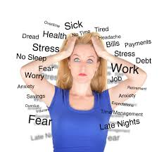
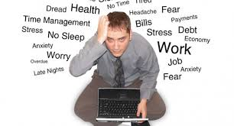

Slide 4
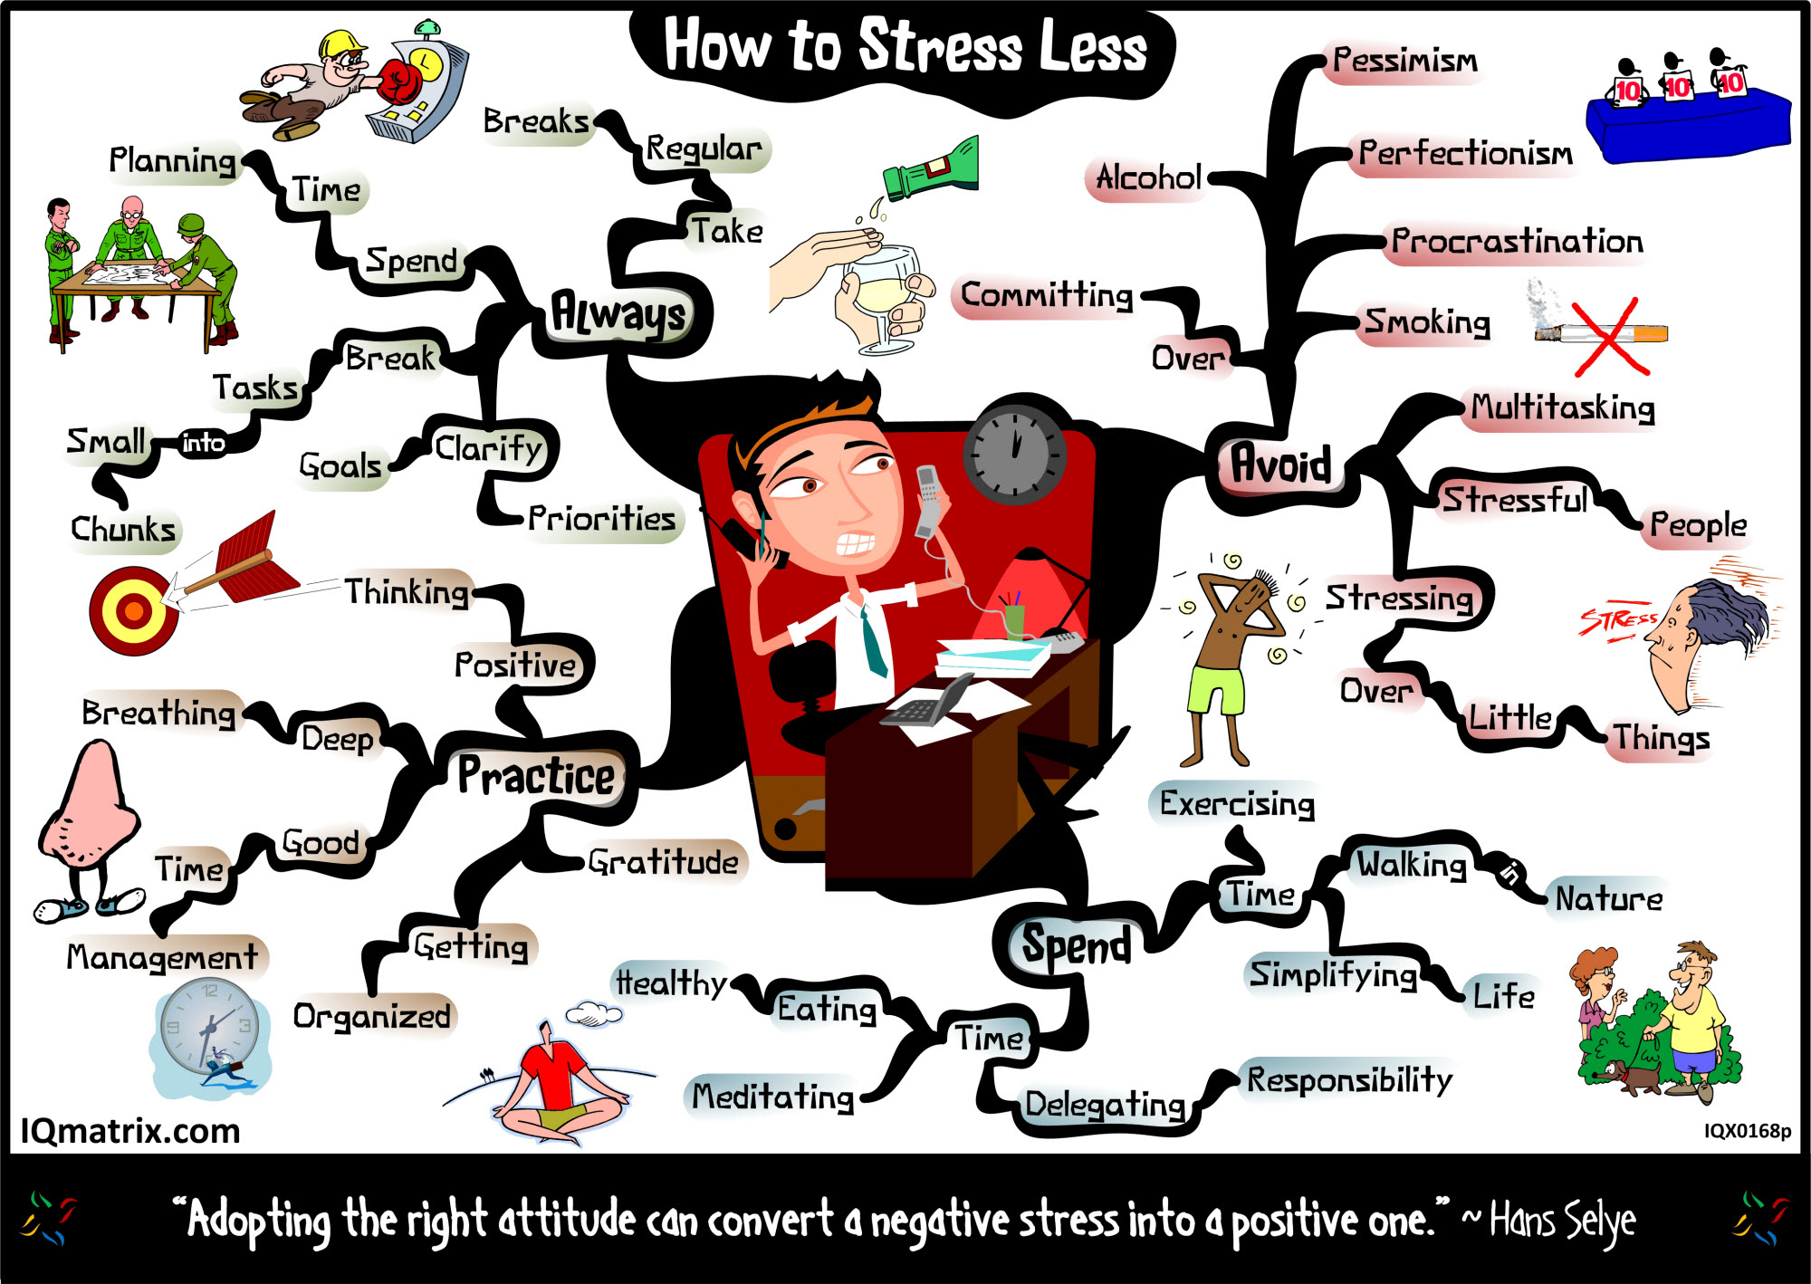

Slide 5
COPE scale
Carver et al: 15 coping strategies .
Questionnaire used to assess an individuals coping strategies. It provides ratings on 15 different strategies.
Handout showing cope scale - discuss

Slide 6
Approach Coping
Roth and Cohen
Coping with stress by tackling the situation directly (long term)

Slide 7
Avoidant
Roth and Cohen
Pretending it does not exist. (short term)

Slide 8
Problem focussed coping
Target the causes of stress (stressors) and deals with them in practical ways to reduce them. Eg: remove the spider.

Slide 9
Emotion focussed coping
Targets the emotional response to the stressor (stage 2) Strategies include denial, distraction (think of other things) and seeking support from friends.

Slide 10
Which is better
Style of coping influenced by the type of stressor. Controllability and perhaps gender.

Slide 11
Tennen et al
Studied patients with chronic pain in a longitudinal study. Used a questionnaire.
  Strategies used simultaneously there is an interaction between the methods of coping
  An increase of pain when using problem focussed coping meant the next day and increase in emotion coping. I.e.: the success or failure of one method led to a decrease or increase of the other method.

Slide 12
Psychological methods of dealing with stress
Cognitive behavioural therapy
Hardiness training

Slide 13
Cognitive behavioural therapy
Alter irrational thoughts.
Stress Inoculation Training SIT
  Conceptualisation - helps identify the stressors.
  Skills training e.g.: relaxation techniques (Le mars)
  Reflect and adapt

Slide 14
Hardiness
Kobasa
Focus on the physiological symptoms of stress. Identify the stressors . Acquire new skills and strategies with therapist.
Reconstruction. Thinks about past stressful events and how they could have been dealt with better.
Get the client improve self-efficacy by taking on past perceived stressors.

Slide 15
Stress Inoculation therapy
Stress Inoculation therapy (SIT) involves three stages.
The first is conceptualization, where the client and therapist identify the source of the stress. This could include keeping a diary of when and where the stressful experiences occurred. During this stage the therapist might even challenge the client’s views.
The second stage allows the client to learn specific skills and to practice them with the therapist.
  Finally the client will try out these skills in the real world. At the same time Reflect and adapt

Slide 16
Question
3 (a) What is meant by a problem-focused approach to coping with stress?
3 (b) What is meant by an emotion-focused approach to coping with stress?

Slide 17
Problem-focused approach
Problem-focused approach to coping with stress involves the person actively trying to do something that deals with the stress. This might involve taking control by getting as much information as they can, considering possible alternative strategies, improving their coping
resources etc.
1 mark for a basic statement and further 2 marks for elaboration. For example, problem focused coping is doing something active such as taking control (1 mark) by finding out as much information about the forthcoming exam as possible and then planning and implementing a revision strategy (2 further marks for elaboration).

Slide 18
Emotion focused coping
Emotion focused coping involves strategies that deal with the emotions linked with the stress, rather than the stress itself. These might include, denial, venting, wishful thinking etc.
1 mark for a basic statement and further 2 marks for elaboration. For example, emotion focused coping is dealing with the emotions created by the stressful event such as through denial (1 mark). The person might carry on as if nothing is wrong and there is no stressor (a
further mark for slight elaboration). Note: social support can be a problem-focused approach (discussing the problem with other
people can help put the problem into perspective and provide practical information). It can also be an emotion-focused approach (getting emotional support from friends). Both are creditworthy.

Slide 19
Question
Karen has been feeling extremely stressed for several months. She has recently been promoted at work and is worried that she is not able to do the job properly in spite of praise from her managers. She also finds it very difficult to say “no” when colleagues ask for assistance. Her health is suffering and she decides to try Cognitive Behavioural
Therapy (CBT) to help manage her stress.
Explain what is involved in Cognitive Behavioural Therapy (CBT) and how it could be used to help Karen.

Slide 20
CBT
CBT is an umbrella term that includes a range of different treatments, such as SIT and hardiness training. All these methods share the common aim which is to change irrational thoughts and cognitive biases. Candidates can refer to a specific method or to CBT in general, either way would be creditworthy. SIT uses conceptualisation and skills training.
CBT could help Karen because she has irrational thoughts (worried she is unable to do the job properly even though she receives praise). The therapist might challenge Karen and ask her for evidence of examples when she couldn’t do her job well. Karen might also practice saying “no” to her therapist so that she can later do so in the real world. Since her problems
appear to be due to her cognitions, CBT would be an appropriate treatment.
For 4-6 marks, there must be active engagement with the scenario (this is not the same as merely using the name ‘Karen’).

Slide 21
Drugs

Slide 22
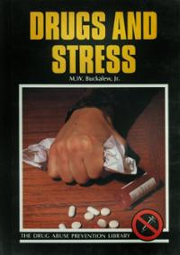
Physiological Methods
PHYSIOLOGICAL METHODS OF STRESS MANAGEMENT Techniques that aim to reduce stress by altering the body’s natural stress responses.
1. DRUGS
What are they? Anxiolytic drugs reduce anxiety. These include:
• Benzodiazepines: e.g. valium. These act on synapses and neurotransmitters, promoting natural biochemical substance called GABA = the body’s natural form of anxiety relief.
  GABA reduces serotonin levels , decreases arousal of neurons ‡ reduced anxiety.
  GABA slows down nerve cell activity, allowing chloride ions into neurons, slowing activity and causing relaxation. Side effects = sleepiness and dependence
• Buspirone: Enhances the effects of serotonin, reducing anxiety. Side effects = depression
How do they work?
All drugs are related to the bodily processes involved in the stress response, i.e. they intervene in the activity of the ANS.
Evaluation
Easy to use Effective Available Short term Only tackle symptoms not the real problem Unpleasant side effects – upset stomach, drowsiness, blurred vision, irregular heart beat Dependency – limit of 4 weeks.

Slide 23
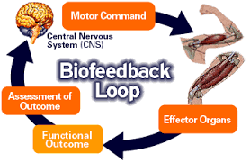

Slide 24
BIOFEEDBACK
2. What is it?
Techniques to learn voluntary control of involuntary behaviours by being made aware of ANS activity.
Learning occurs through:
A. Feedback
    a patient is connected to various monitoring devices to provide info about ANS activity e.g. light indicating high blood pressure.
  B. Relaxation
    a patient is taught methods of relaxation. Reduces activity of sympathetic nervous system and activating the parasympathetic nervous system.
  C. Operant conditioning
      certain behaviours are reinforced because they result in a desirable outcome.
Miller and DiCara Used 24 rats, keeping them alive through artificial respiration. Half were rewarded when their heart rate slowed down. Half were rewarded when their heart rate speeded up. Heart beats adapted to what they were rewarded by.
Evaluation
Effectiveness – Dworkin and Dworkin used biofeedback to teach sufferers of scoliosis to control their back muscles and alter their posture. No side effects Long lasting methods – future Non-invasive Expensive Time Consuming Treats the symptoms not the problem

Slide 25
Question
Long-term stress is often accompanied by psychological and physical changes.
Drug therapy is sometimes used to reduce these effects of stress.
Outline drug therapy as a method of stress management. 4 marks

Slide 26
Answer
The two main groups of drugs used to manage stress are Benzodiazepines and Beta-blockers. BZs act on the brain by increasing the action of GABA. This neurotransmitter reduces the activity of other neurotransmitters in the brain.
Beta-blockers act directly on the cardiovascular system. They reduce any increase in heart rate and blood pressure that may arise as a result of stress.
Examiners should be aware of a breadth/depth trade off: one type in detail or both in less detail.

Slide 27
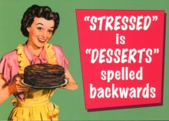

Slide 28
Alternative methods
Muscle relaxation and meditation
Jacobson tensed and relaxed method. Studies have shown (Murphy) they are effective stress management technique.
Physical exercise (think fight or flight).
Throne et al found that it reduced stress in firefighters
Social Support (network) Includes support at work.
Glaser et al found that it reduces blood pressure

