Slide 1
Stress
Link of complete overview
News reader idea?

Slide 2
Exam question.
Explain what is meant by stress.
Stress is experienced when there is a difference between the perceived demands of a situation and an individual’s perceived ability to cope with that situation.

Slide 3
The Syllabus
Stress as a bodily response
The body’s response to stress, including the pituitary-adrenal system and the sympathomedullary pathway in outline
Stress-related illness and the immune system.

Slide 4
Words
Stress =
  stress response: Selye (rats and injections/individual differences)
  Stimuli: Can be defined as stressful eg: Death.
  Transactional Model: Cox and Mackay. Key process is appraisal:
  This is split in 2 parts:
      Primary appraisal
      Secondary appraisal

Slide 5
Transactional model
Primary and Secondary appraisal:
‘When an imbalance or discrepancy exists between perceived demands and perceived coping resources then a state of stress exists’

Slide 6
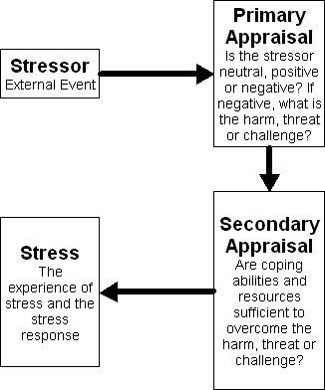
Diagram of Transactional Model explaining Primary and secondary.

Slide 7

What is good!
Transaction model takes into account individual differences eg: spiders.
Stressor: a stimulus or situation imposing demands on an individual.

Slide 8
Good
So as well as physiological responses it takes into account reactions such as emotional anxiety or depression.

Slide 9
Physiological Response
Neuron Cells specialised to conduct electrical impulses (nervous system).
Action potential = Electrical activity (nerve impulses). Everything is this ?
This begins on the dendrites and travel along the axon to the synapses.
Watch a video

Slide 10
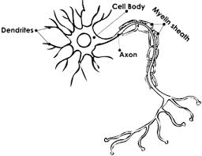

Slide 11
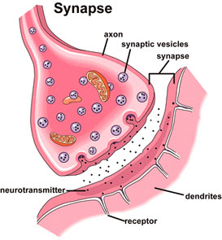
Synapse

Slide 12
Synapse
All or none – A threshold must be reached for it to fire.
Limited number of Neurotransmitters and associated receptors. Synapses can be defined by the neurotransmitter they release.
  GABA synaptic neurotransmitter involved in the action of anti-anxiety drugs.
  Dopamine synaptic neurotransmitter involved in the action of antipsychotic drugs
  Noradrenaline hormone released from adrenal medulla (also a neurotransmitter) acts on heart and circulatory system.
  Serotonin synaptic neurotransmitter involved in the action of antidepressant drugs

Slide 13
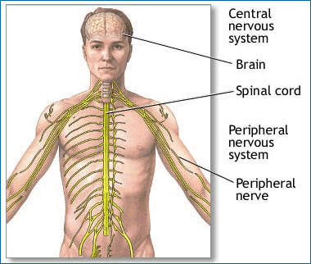
Nervous system
Sensory pathways: sensory receptors to brain (not eyes or ears)
Motor pathways: brain control movement

Slide 14
The autonomic Nervous System
Located in the brainstem part of the Peripheral nervous system controls such things as heart rate, temperature and blood pressure. Central to homeostasis.
ANS has two parts which are usually in balance.
  Sympathetic branch: arousal or dominance leads to increase heart rate and blood pressure.
  Parasympathetic branch: Physiological calm
  Note the Hypothalamus activates the sympathetic branch of ANS if in a dangerous or threatening perceived situation

Slide 15
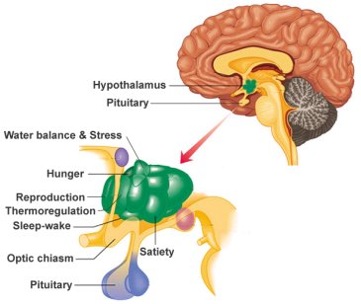

Slide 16
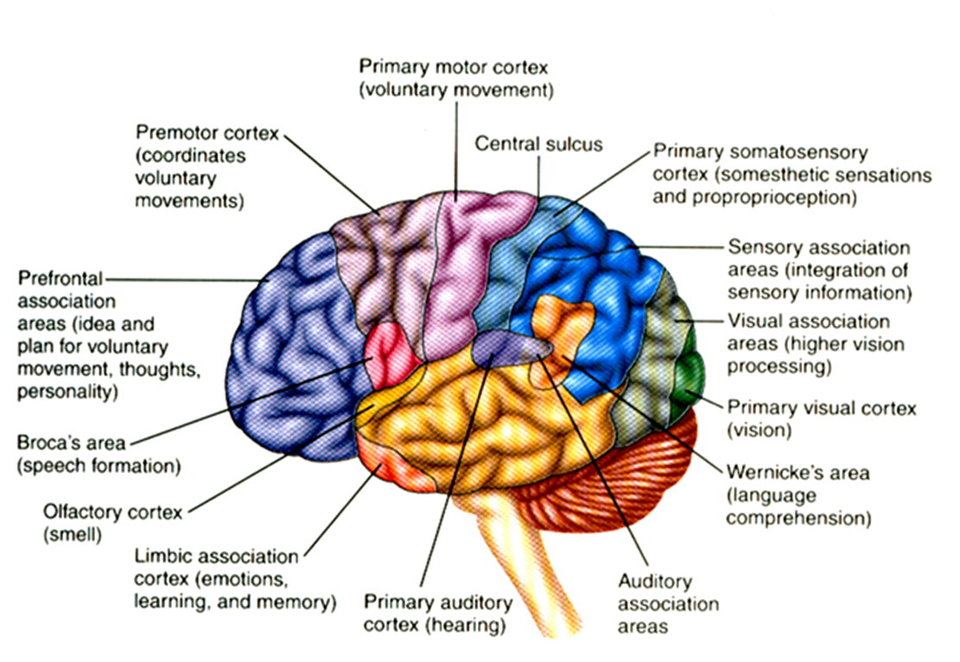

Slide 17
Sympathomedullary Pathway
The hypothalamus activates the adrenal medulla. The adrenal medulla is part of the autonomic nervous system (ANS).
The ANS is the part of the peripheral nervous system that acts as a control system, maintaining homeostasis in the body. These activities are generally performed without conscious control.

Slide 18
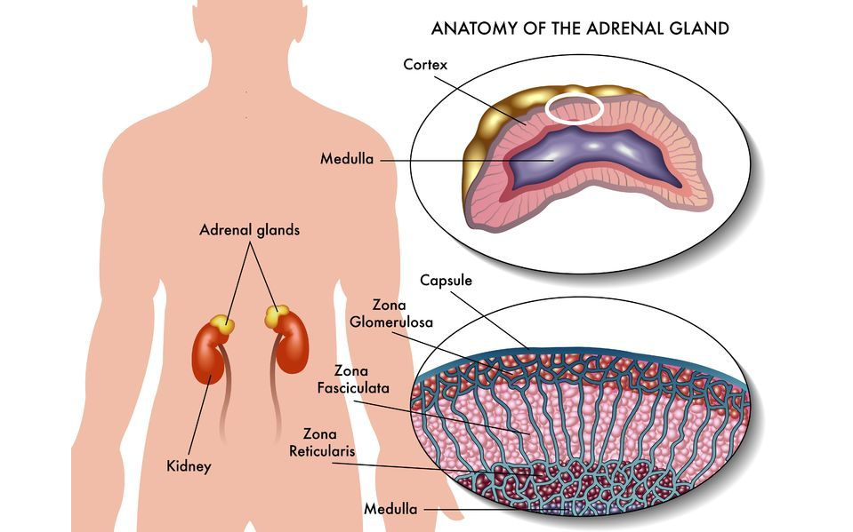

Slide 19
Sympathomedullary Pathway
The adrenal medulla secretes the hormone adrenaline. This hormone gets the body ready for a fight or flight response. Physiological reaction includes increased heart rate.
Adrenaline lead to the arousal of the sympathetic nervous system and reduced activity in the parasympathetic nervous system.

Slide 20
Sympathomedullary Pathway
Adrenaline creates changes in the body such as decreases (in digestion) and increases (sweating, increased pulse and blood pressure).
Once the ‘threat’ is over the parasympathetic branch takes control and brings the body back into a balanced state.

Slide 21
Sympathomedullary Pathway
No ill effects are experienced from the short-term response to stress and it further has survival value in an evolutionary context.

Slide 22
Knowledge of main features of Sympathomedullary pathway
Main features of the Sympathomedullary pathway are that the hypothalamus activates the sympathetic nervous system, which then stimulates the adrenal medulla to release the hormones adrenaline and noradrenaline into the bloodstream. This gets the body ready for fight-or-flight, eg increase blood pressure and heart rate.

Slide 23
Pituitary-Adrenal System
The Hypothalamic Pituitary-Adrenal (HPA) System
The stressor activates the Hypothalamic Pituitary Axis
The hypothalamus stimulates the pituitary gland
The pituitary gland secretes adrenocorticotropic hormone (ACTH)
ACTH stimulates the adrenal glands to produce the hormone corticosteroid
Cortisol enables the body to maintain steady supplies of blood sugar
Adequate and steady blood sugar levels help person to cope with prolonged stressor, and helps the body to return to normal
The adrenal cortex releases stress hormones called cortisol. This have a number of functions including releasing stored glucose from the liver (for energy) and controlling swelling after injury. The immune system is suppressed while this happens.

Slide 24
Knowledge of main features of pituitary-adrenal system
Main features of pituitary-adrenal system are that the hypothalamus communicates with the pituitary gland causing it to release ACTH. This hormone is then detected in the bloodstream by the adrenal cortex, which then releases corticosteroids such as cortisol and corticosterone. The corticosteroids have a range of effects such as causing the liver to release glucose.

Slide 25
Evaluation
Strengths:
Measuring stress hormones gives an objective measure of stress.
Fight/flight response can be seen in all mammals in response to threats.
Weakness:
There is considerable variation in level and type of hormones released by different people and in response to different stressors – not a simple physiological process.
People without adrenal glands need hormonal supplements to survive stress.
Symington (1955) found that conscious dying patients showed different stress reactions to unconscious ones. Suggests that psychological factors play a role.

Slide 26
Video review
The body’s response to stress, including the pituitary-adrenal system and the sympathomedullary pathway in outline

Slide 27
Selye again!
The General Adaptation Syndrome (GAS)
Alarm . Prepares you to respond to environmental demands. The HPA system is activated: the sympathetic branch of the ANS is aroused and ACTH and adrenal hormones are released in readiness for fight or flight.
Resistance. If the stressor persists, the body adapts by returning to a normal level of functioning while coping with the stressor. Hormone production is maintained but at lower levels.
Exhaustion. Eventually the body’s resources are depleted. Adrenal glands are not functioning, leading to low blood sugars and various psychosomatic disorders such as ulcers.
GAS – too many hormones

