Slide 1
Psychological approaches to psychopathology - Behavioural
Link

Slide 2
The behavioural approach to explaining and treating phobias: the two-process model, including classical and operant conditioning; systematic desensitisation, including relaxation and use of hierarchy; flooding.

Slide 3
Read this
The behaviourist approach dominated psychology in the first half of this century, especially in the USA. The goals of behaviourism were to move psychology toward a scientific model, which focused on the observation and measurement of behaviour. Its assumptions were that behaviour is primarily the result of the environment rather then genetics (or instincts) and so the behaviourists reject the view that abnormal behaviour has a biological basis. Like the psychodynamic theorists, behaviourists have a deterministic view of mental disorders: they believe that our actions are largely determined by our experiences in life. However, unlike Freud, they see abnormal behaviour is a learned response (through conditioning) and not as the result of mysterious (and they would argue unknowable) unconscious processes. While much of our behaviour is adaptive, helping us to cope with a changing world, it is also possible to learn behaviours that are abnormal and undesirable. However, such maladaptive learning can be treated by changing the environment so that un-learning could take place.
Example
A patient’s fear (phobia) of heights would be explained through the process of classical conditioning. Some time in the past, she would have learned to associate the emotion of fear with the stimulus of being in a high place through a chance association between the two stimuli. As a result, she would avoid heights, and therefore not have the opportunity to relearn the association in a more adaptive way. Treatment would involve desensitising the fear through conditioning techniques.

Slide 4
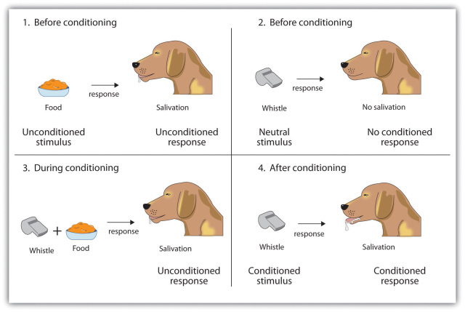
Classical Conditioning

Slide 5
Look back
Attachment
  Baby gets food (unconditioned response)
  Mother food baby (during conditioning)
  Baby attaches to mother (condition response)

Slide 6
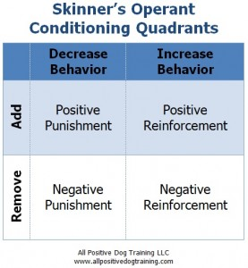
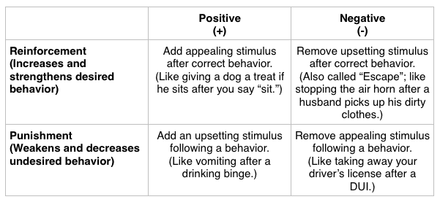
Operant Conditioning

Slide 7
Look Back
Mother feeds baby - baby is happy. Positive reinforcement.
Positive reinforcement of mother feeding baby.
Who is Harlow?

Slide 8
Classical conditioning as an explanation of phobias
All behaviour is learned through stimulus-response associations.
Watson and Rayner (1920) proposed that children learn phobias through paired associations. It is suggested that through classical conditioning people can learn to associate an unconditioned response with a neutral stimulus. Therefore resulting in a conditioned response that can lead to a phobia.
Example:
Fear of heights = If a person climbs to the top of a high building (stimulus), looks down and feels nausea and dizziness (response), the association between the two, and the response will cause the phobia.
Watch Little Albert

Slide 9
Little Albert (note)
Did it also apply to humans? In a famous (though ethically dubious) experiment Watson and Rayner (1920) showed that it did.
Little Albert was a 9-month-old infant who was tested on his reactions to various stimuli. He was shown a white rat, a rabbit, a monkey and various masks. Albert described as "on the whole stolid and unemotional" showed no fear of any of these stimuli. However what did startle him and cause him to be afraid was if a hammer was struck against a steel bar behind his head. The sudden loud noise would cause "little Albert to burst into tears.
When Little Albert was just over 11 months old the white rat was presented and seconds later the hammer was struck against the steel bar. This was done 7 times over the next 7 weeks and each time Little Albert burst into tears. By now little Albert only had to see the rat and he immediately showed every sign of fear. He would cry (whether or not the hammer was hit against the steel bar) and he would attempt to crawl away.
Watson and Rayner had shown that classical conditioning could be used to create a phobia. A phobia is an irrational fear, i.e. a fear that is out of proportion to the danger. Over the next few weeks and months Little Albert was observed and 10 days after conditioning his fear of the rat was much less marked. This dying out of a learned response is called extinction. However even after a full month it was still evident.

Slide 10
Operant Conditioning as an explanation of abnormality
Skinner (1974) explains that behaviour is influenced by the consequences of our actions in terms of positive and negative reinforcement.
Positive reinforcement = childhood aggression is reinforced then the behaviour is likely to be repeated and may explain how a child learns that aggressive behaviours are appropriate.
Also, anxiety or depression might receive reward in the form of attention and concern, also making the behaviour be repeated. This positive reinforcement means that the person will repeat that behaviour in the future as they want the positive attention.
Negative reinforcement = maintains a learnt avoidance of a phobia as removal (moving away from the phobia) of the negative emotions and feelings will reinforce the behaviour. Therefore allowing the individual to learn that avoiding situations will reduce the negative emotions.
Another example is when people suffer with addictions the removal of the withdrawal symptoms by the drug negatively reinforces the abnormal behaviour.

Slide 11
Social Learning Theory as an explanation of abnormality
Bandura suggests that if we observe behaviour, are able to recall the details, have the ability to replicate it and the opportunity to, then if we are motivated by reinforcements… we will imitate and repeat it.
Children learn from role models within their lives eg. parents, older siblings and teachers. Antisocial behaviour can be explained by Social Learning Theory, if a child observes an aggressive model who is rewarded. This can lead to imitation therefore the child is likely to imitate antisocial behaviours like aggression. Also some phobias develop due to observing how a model responds to a stimulus. If a child observes a model respond in a negative/maladaptive way to a stimulus then it is likely that the child will also imitate that behaviour as they learn to be frightened of that object.

Slide 12
Evaluation of the behavioural model
Among the strengths of the model are:
It has led to the development of specific behavioural therapies, many of which have had high success rates
It is widely regarded as lending itself to scientific study and evaluation
Proponents of the model argue that once the symptoms of an illness are alleviated, the complaint disappears
Weaknesses include:
The model is reductionist in the sense that it reduces the complexity of human behaviour to behavioural responses to environmental stimuli
Only the symptoms of illnesses are treated, not the underlying causes
The model provides a limited view of the causes of mental illness and does not explain the evidence relating to genetic predispositions to mental illness
Environmental causes of abnormal behaviours are only rarely discovered in patients

Slide 13
Question
‘Behaviourists believe that all behaviour, both normal and abnormal, is learned through processes such as classical conditioning, operant conditioning and social learning.’ Discuss the behavioural approach to explaining psychological abnormality.

Slide 14
Answer
AO1 = 6 marks Knowledge of behavioural approach to psychopathology Remember not to credit information given in the quote Answers that only consider therapies, maximum 3 AO1 marks and 3 AO2 marks. The emphasis of the behavioural approach is on the environment and how the behaviour is acquired, through classical conditioning, operant conditioning and social learning. For marks in the top two bands, the focus must be on explaining psychological abnormality, rather than on behaviour in general. If no attempt to explain abnormality, maximum 3 marks. Examiners should be aware this might result in quite a wide range of responses being awarded 3 marks. AO2 = 6 marks Commentary on behavioural approach to psychopathology The commentary can include strengths; such as it has provided some convincing explanations for some disorders such as phobias and has also led to some very successful therapies (systematic desensitization). The weaknesses are that it ignores the role of biology and there is plenty of evidence to support a genetic transmission of some disorders. An evaluation of therapy could consider whether it is effective and for what disorders. Studies (eg “Little Albert”) can be used as commentary.

