Slide 1
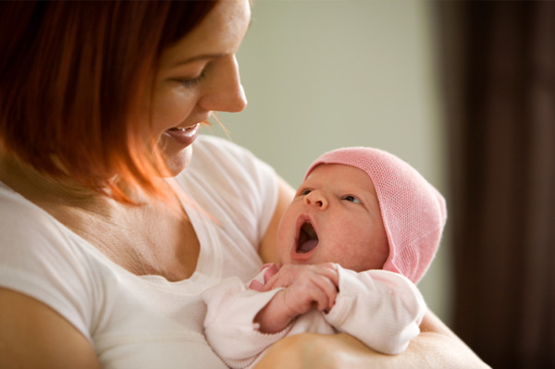

Slide 2
What is Attachment
An emotional tie or relationship between two people shown in their behaviour.

Slide 3
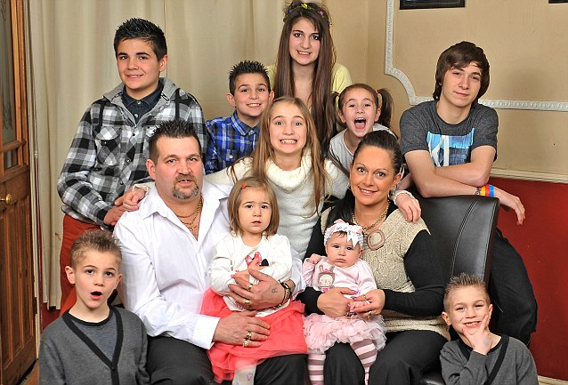

Slide 4
Attachment is Shown
Seeking proximity
Distress in separation
Joy on reunion
General orientation (wanting to be close)

Slide 5
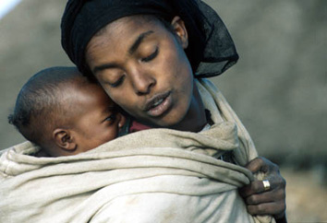

Slide 6
ethology
The study of animal behaviour. Helps survival. Two people together are more likely to survive than separate. Evolutionary. Lorenz!

Slide 7


Slide 8
Critical Period
A specific period of time in which something has to develop. Limbs in the womb from the embryo. If interfered with may not develop properly and will have a lasting effect.

Slide 9
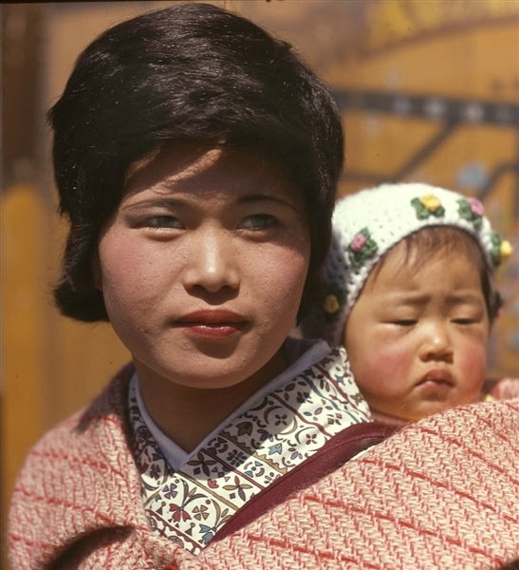

Slide 10
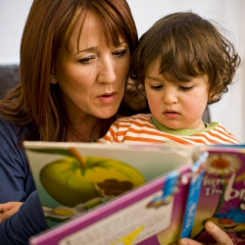

Slide 11
Sensitive Period
A period of time in which something is likely to occur. The development of speech in young children. We saw earlier that this can be effected by isolation.

Slide 12
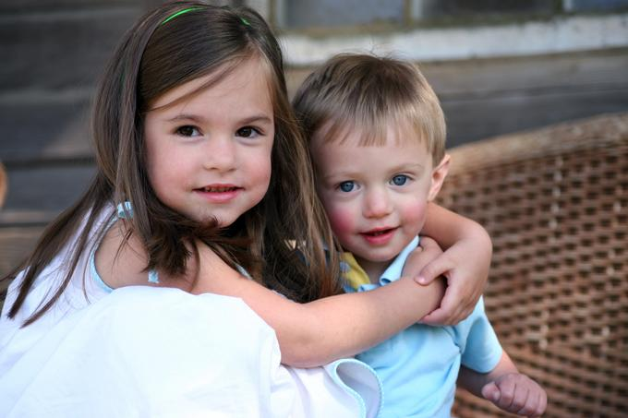

Slide 13
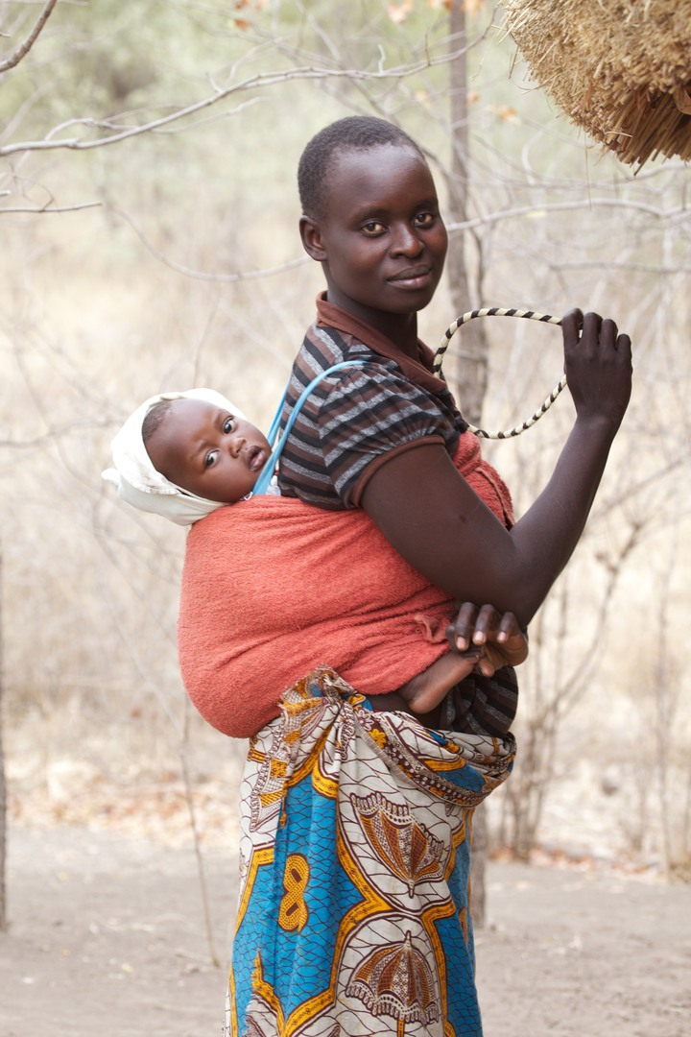

Slide 14
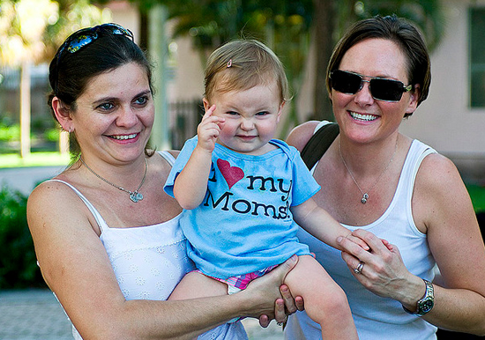

Slide 15
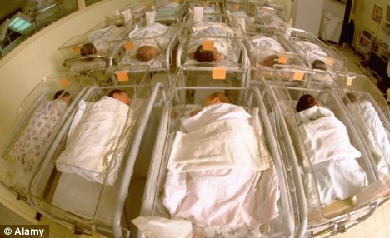

Slide 16
Klaus and Kennell
Skin to skin
Evolution: Human babies are helpless.
Led to greater closeness
Experiment criticised due to group.
De Chateau et al replicated with Swedish mothers.

Slide 17
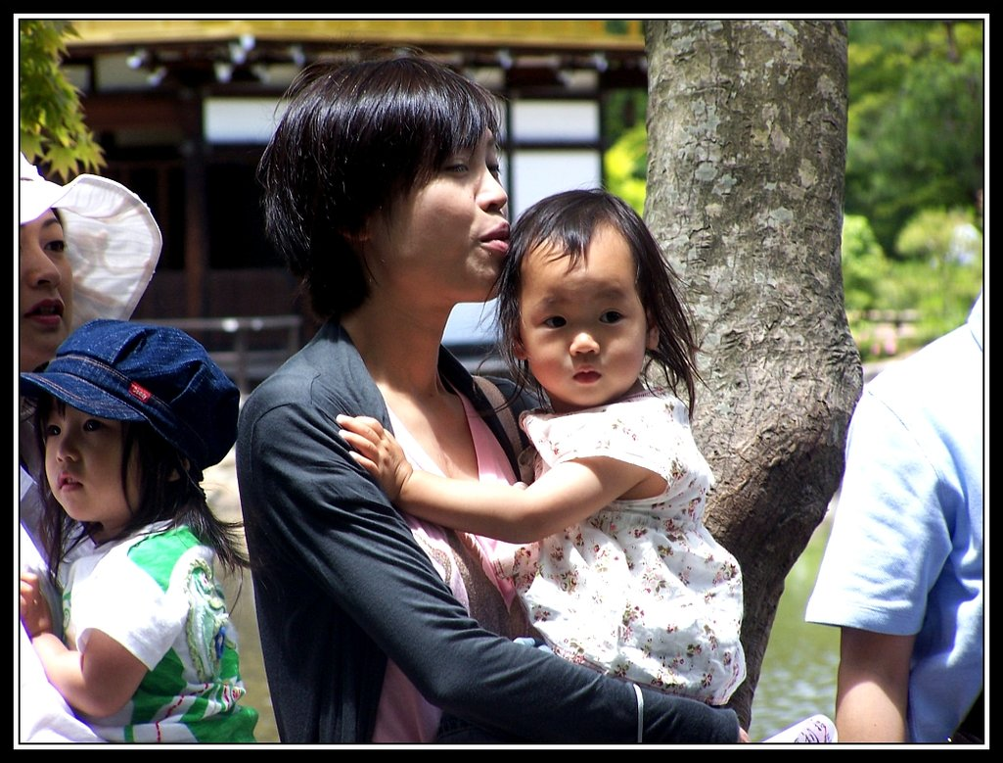

Slide 18
Schaffer and Emerson
Phase of attachment: | Age range: | Characteristics of phase:
Pre-attachment phase | 0-3 months | At about 6 weeks, infants begin to treat other humans differently from objects by smiling and gurgle at them.
Indiscriminate attachment phase | 3-7 months | Infant can distinguish between familiar and unfamiliar people but is quite happy to be comforted by anyone.
Discriminate attachment phase | 7-9 months | Infant distinguishes between carers and strangers and exhibits distress or separation anxiety when left alone (they have developed object permanence) and may be fearful of the strangers.
Multiple attachment phase | 9+ months | Attachments develop with other people (for example, grandparents or brothers and sisters), although the original attachment remains the strongest.

Slide 19
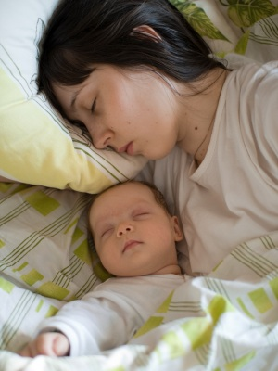

Slide 20
