Slide 1
Attachment – Lesson Two
PSYA1

Slide 2
What is Attachment?
A bond formed between animals or people, and continues to bind them through time
Wanting to gain and to keep close proximity to that person
Behaviours to keep the close proximity will be following, clinging, smiling, crying and calling

Slide 3
What theory did we learn about?
What was it called?
Explain the theory

Slide 4
Learning Theory
(Dollard & Miller, 1949)
Attachment is a set of learned behaviors (i.e. results from experience of the environment, not innate processes)
  Classical conditioning (association) Pavlov
  Operant conditioning (consequences) Skinner

Slide 5
Unconditioned Stimuli
Unconditioned Stimuli: An aspect of the environment which produces an automatic unlearned response. Dog salivating when given food.

Slide 6
Unconditioned Response
An unlearned reflex response to an unconditioned stimuli. The pupil of the eye changing with the difference in light.

Slide 7
Cupboard Love
Learned behaviour by association.

Slide 8
How do you think classical conditioning can explain attachment of a baby to it’s mother?

Slide 9
  Infant learns to associate feeding with primary carer/mother
  Mother acquires comforting properties by association

Slide 10
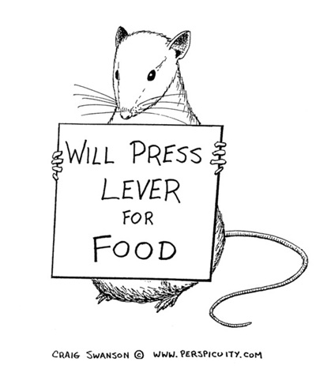
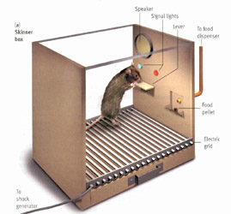
Operant conditioning – Skinners rats

Slide 11
Operant conditioning – Skinners rats

Slide 12
Operant conditioning key points
Will complete a task in order to gain reward
Called positive reinforcement – gaining a reward reinforces the behaviour, and therefore you are likely to repeat the behaviour
Negative reinforcement is learning through punishment rather than reward

Slide 13
How do you think operant conditioning can explain attachment of a baby to it’s mother?

Slide 14
  Infant learns that crying and smiling brings positive response from adults (positive reinforcement)
  Adult learns that responding to cries etc. brings relief from noise (negative reinforcement)

Slide 15
Evaluation of Learning Theory
Strengths?
+ Provides an adequate explanation as to why attachments form

Slide 16
Evaluation of Learning Theory
Weaknesses?
Original Learning Theory uses food to develop the attachment. There is no psychological evidence to show feeding has anything to do with attachment
Harlow’s Monkeys (1959) – contact comfort is more important than food in the development of attachment (video)
Supported by study with humans – Schaffer and Emerson (1964)

Slide 17
Swap homework
Argue what this is?
Skinner

Slide 18
Answer
The cat has learned during conditioning that the food and door opening occur together a number of times
The door opening then becomes a conditioned stimulus which produces the response of running to the cupboard for food.

Slide 19
2. Use operant conditioning to explain how you could get people to smile at you more often.

Slide 20
Answer?
Smile back at them often – positive reinforcement
Give them a reward – positive reinforcement
Punish them when they don’t smile at you – negative reinforcement.

Slide 21
3. Write a 100 word outline of the learning theory explanation of attachment

Slide 22
Answer
Classical conditioning
  Pavlov
  Stimulus/Response
Operant conditioning
  Skinner
  Positive and negative reinforcement
Overview: all behaviour is learned through experiences and is not innate

Slide 23
4. Write a 100 word evaluation of the learning theory explanation of attachment. Remember you should not describe research studies but must use them as part of an effective commentary

Slide 24
Answer
Strengths
  Supported by Pavlov’s and Skinner’s experiments
  Is a viable way of proving attachment through food
Weaknesses
  Harlow’s monkeys
  Schaffer and Emerson
  Food may not have anything to do with attachment

Slide 25
Learning Objectives
To understand and evaluate the evolutionary theory in terms of attachment
Develop exam skills in essay writing

Slide 26
Evolutionary Theory
What is evolution?

Slide 27
Evolutionary Theory
Bowlby (1953)
Attachment is biologically pre-programmed into children at birth
  Encoded in the human genes
  Evolves and persists because of its adaptiveness (i.e. it is evolutionarily useful)

Slide 28
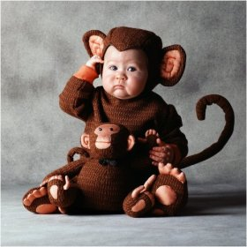
Evolutionary Theory
  Evolution is the process whereby USEFUL FEATURES are introduced into a species. Features are useful if they help the animal SURVIVE long enough to successfully REPRODUCE. To survive and reproduce, animals need to be WELL ADAPTED to their environment.
  For this reason, useful features are said to be ADAPTIVE.

Slide 29
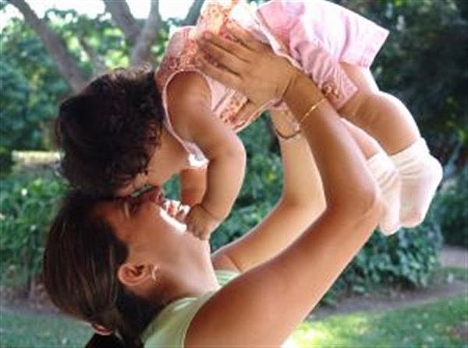
Bowlby’s Theory of Attachment
Bowlby (1958) proposed that human infants have an innate tendency to form attachments to their primary care giver, most often their mother.

Slide 30
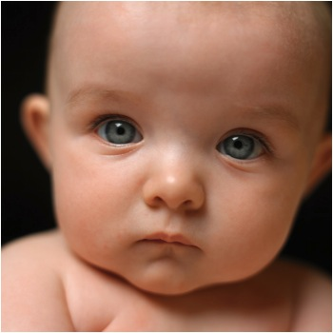
ASCMI
Bowlby’s theory of attachment has a number of parts, which can be broken down into the following
  A: Adaptive
  S: Social Releasers
  C: Critical Period
  M: Monotropy
  I: Internal Working model

Slide 31
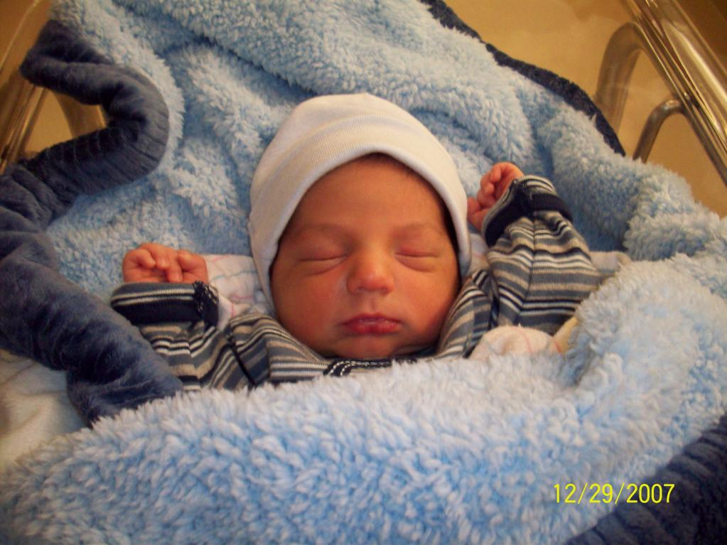
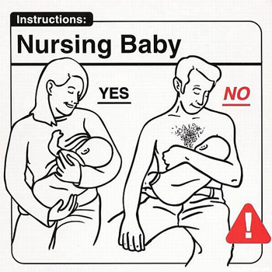
Bowlby (1958)
Attachments are Adaptive.
This means they give our species an ‘adaptive advantage’, making us more likely to survive. This is because if an infant has an attachment to a caregiver, they are kept safe, given food, and kept warm.

Slide 32
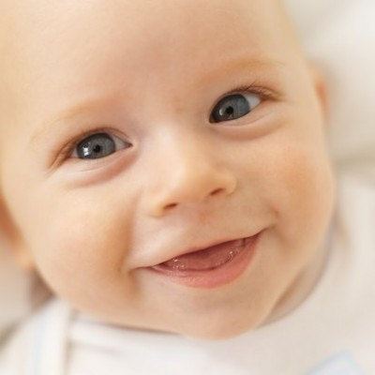
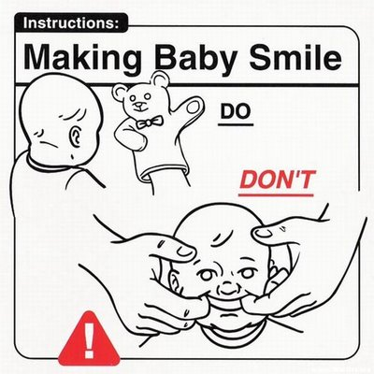
Bowlby (1958)
Babies have Social releasers, which ‘unlock’ the innate tendency of adults to care for them.
These Social releasers are both:
  Physical – the typical ‘baby face’ features and body proportions
  Behavioural – e.g. crying, cooing, smiling

Slide 33
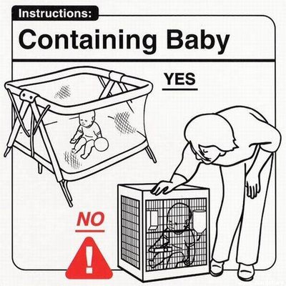
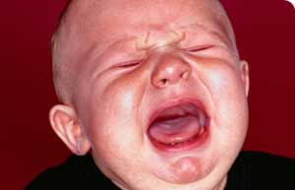
Bowlby (1958)
Babies have to form the attachment with their caregiver during a Critical period.
This is between birth and 2½ years old. Bowlby said that if this didn’t happen, the child would be damaged for life – socially, emotionally, intellectually, and physically

Slide 34
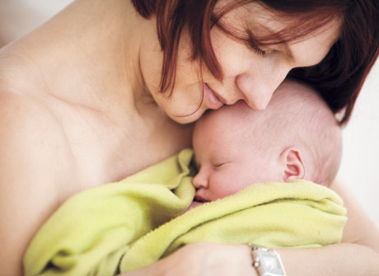
Bowlby (1958)
Bowlby believed that infants form one very special attachment with their mother. This special, intense attachment is called Monotropy. If the mother isn’t available, the infant could bond with another ever-present, adult, mother-substitute.

Slide 35
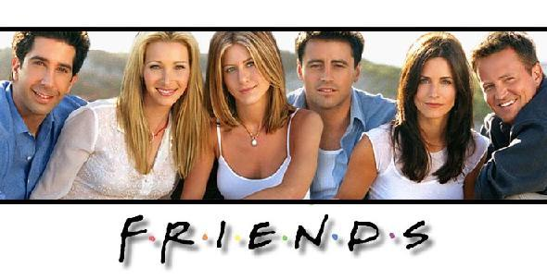

Bowlby (1958)
Through the monotropic attachment, the infant would form an Internal working model. This is a special model for relationships. All the child’s future adult relationships will be based on the relationship with the mother.

Slide 36
Task One – Pictures of Animals

Slide 37
Evolutionary Theory
Main hypotheses:
  Attachments will form with those who respond to child’s signals
  Attachment will correlate with other aspects of (biological) development
  There will be a special attachment figure that is more important than others
  Disruption of attachments will have developmental consequences

Slide 38



Evaluation
Research Strengths and Weaknesses
Page 38-39
Make notes and feedback to class

Slide 39
Strengths
Lorenz
Institutional Care - Hodges and Tizard
Universality – Tronick
Monotropy and hierarchy – Schaffer and Emerson
Caregiver Sensitivity – Harlow, Schaffer and Emerson
Continuity hypothesis - Sroufe

Slide 40
Weaknesses
Multiple attachments – Rutter
Temperament Hypothesis

Slide 41
Task Two
Essay-based question
“Discuss two explanations of attachment”. (16 marks)
Use p.39 ‘Commentary corner’ to help you
Open Book – this will be marked

Slide 42
Task Three (and for homework):
Create a poster for Learning Theory – Explain Classical and Operant Conditioning, strength’s and weaknesses
Include studies to support the points you make
Create a poster for Evolutionary Theory– Explain the theory, strength’s and weaknesses
Include studies to support the points you make

