Slide 1
Attachment – Lesson Three
PSYA1

Slide 2
Test
Essay-based question
“Discuss two explanations of attachment”. (16 marks)

Slide 3
Task One
Match up the cards

Slide 4
Task Two
Fill in the gaps

Slide 5
Lesson Objectives
To find out how babies differ in the types of attachment behaviours they show
To investigate what behaviours are shown by babies with secure and insecure attachment types

Slide 6
Mary Ainsworth introduction
Bowlby focused on universality
Ainsworth more interested in individual differences – the different types of attachment an infant can form with their caregiver
Supports Bowlby with an explanation that the attachment figure is a secure base for an infant to explore the world from

Slide 7
The Strange Situation
Ainsworth (1978)
  Investigation of the quality of attachment between a caregiver and child.
Aim
  To see how an infant behaves under conditions of mild stress
Participants
  106 middle class infants

Slide 8
The Strange Situation
8 episodes, each one lasting about 3 minutes
  Mother and baby enter room.
  Mother sits and responds to infant if it wants attention
  Stranger enters, talks to mother and gradually approaches baby. Mother leaves.
  Stranger and baby together
  Mother returns stranger leaves. When baby is settled, mother leaves again
  Baby is alone
  Stranger returns and is alone with baby
  Mother returns and stranger leaves.

Slide 9
The Strange Situation
Watch video

Slide 10
The Strange Situation
The child in the video is what Ainsworth described as “securely attached”
  What behaviour did that child exhibit?
  What other behaviour could a different child show in the same situation?

Slide 11
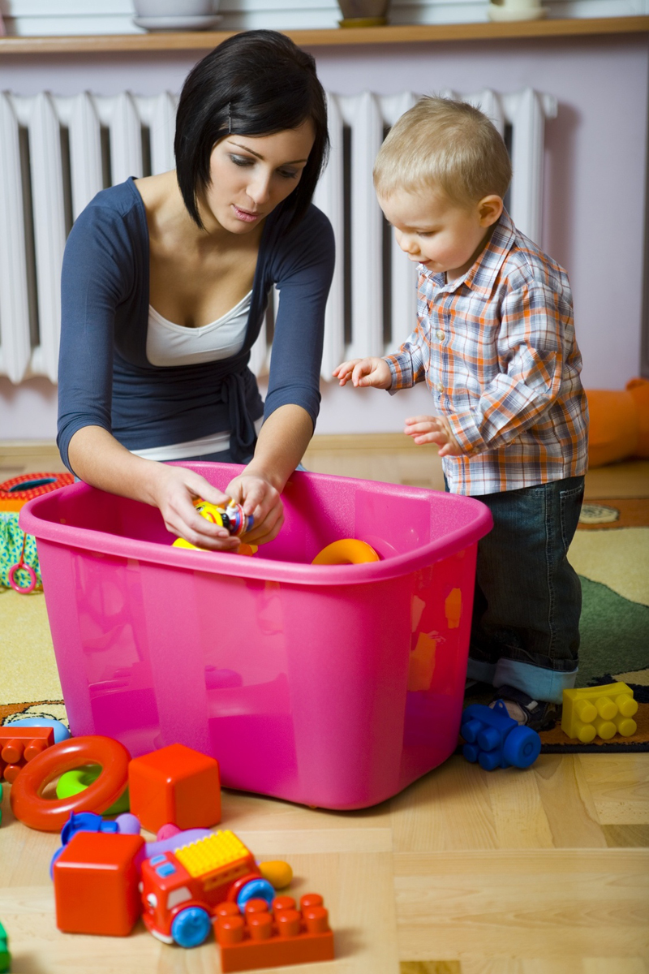
The Strange Situation
Findings
  Ainsworth found similarities between the way children react in the strange situation. She categorised these reactions into secure and insecure attachments.
  There are two types of insecure attachment

Slide 12
The Strange Situation
Secure Attachment (Type B)
  70% of children were found to be securely attached
  The baby will play happily while the mother is present, whether the stranger is present or not. Mother largely ignored as she can be trusted to be there if needed
  Clearly distressed when the mother leaves, and seeks immediate contact with her on her return, calming down quickly.
  Distress is caused by the mother’s absence, not by being alone. The stranger and the mother are treated very differently.

Slide 13
The Strange Situation
Insecure – Anxious Avoidant (Type A)
  15% of children fall into this category
  Baby largely ignores mother due to indifference.
  No or little sign of distress when the mother is absent, and actively ignores her on her return
  Distress is caused by being alone, and the infant can be comforted by the stranger as easily as the mother.
  The mother and the stranger are treated in much the same way.

Slide 14
The Strange Situation
Insecure – Anxious Resistant (Type C)
  15% of children are Type C.
  Baby is fussy and wary while the mother is present. Cries more than usual.
  Has difficulty in using mother as a safe base
  Very distressed when mother leaves and seeks contact with her on her return. However also shows anger and resists contact.
  The baby is ambivalent towards the mother, and resists the stranger’s efforts to make contact.

Slide 15

Attachment Patterns and Internal Working Models
SECURE: Even when Mum’s not here, I
can count on her. After all, she’s always
been there when I needed help.
ANXIOUS: Sometimes Mum is there and
sometimes not. What if something goes
wrong today? What will I do? I hate
feeling this way! Where is she??
AVOIDANT: She’s never around, but I
don’t care. I didn’t want her anyway...

Slide 16
What type of attachment?
Read the handout. Are these children
  Securely attached?
  Insecure – Anxious avoidant?
  Insecure – Anxious Resistant?

Slide 17
Task
Complete the attachment types handout
Use p.40-41

Slide 18
Extra attachment type…
Main and Solomon (1986)
  Re-analysis of Strange situation – a fourth attachment type
  Insecure disorganised (Type D) – lack of consistent patterns of social behaviour. Don’t deal with separation well
  Shows strong attachments, then avoidance, fearful towards caregiver

Slide 19
Evaluation
Ethics?

Slide 20
Evaluation
Sample?

Slide 21
Evaluation
Sample?
106 American infants

Slide 22
Evaluation
Validity?

Slide 23
Evaluation
Validity?
Does the experiment measure what it was supposed to?
Does the experiment measure different types of attachment, or the quality of a particular relationship?
Main and Weston - Possibly dependent on which parent they are with – possibly therefore not valid as it measured a specific relationship and not an attachment type
Does it matter? Only one relationship determines the attachment type (monotropy)

Slide 24
Evaluation
Predictive Validity?
Can we predict future behaviours due to early attachment types found?

Slide 25
Predictive Validity
Behaviour in later childhood
Prior and Glaser – longitudinal study – found link:
  Secure (B) = less emotionally dependent, good interpersonal harmony
  Avoidant (A) = later aggressiveness, negative affect
  Disorganised (D) = hostile and aggressive

Slide 26
Predictive Validity
Adult romantic behaviour
Hazan and Shaver – ‘love quiz’
  Secure (B) = Positive love relationships, trusts others and believes in enduring love
  Avoidant (A) = fearful of closeness, believes love won’t lost and is not necessary to be happy
  Resistant (C) = preoccupied with love – fall in love easily but have trouble finding true love

Slide 27
Evaluation
Complete the guide sheet of the evaluation of the ‘Strange Situation’ experiment

Slide 28
Task
Complete the outline guide sheet of Ainsworth’s ‘Strange Situation’ experiment
Use p. 40-43

Slide 29
What factors might affect attachment type?

Slide 30
1. Sensitivity
Ainsworth – Maternal Sensitivity Scale
  Rated mother’s behaviours
  Sensitivity to infant signals
  Acceptance/rejection of infant
  Ignoring or accessing the child’s needs

Slide 31
Findings
Securely attached – More sensitive mothers, accepting, co-operative and accessible
Insecurely attached – more unresponsive to crying and less affectionate
Avoidant – mothers were more rejecting, paid less attention to infants when entering room
Resistant – mothers occupied with routine activities when holding infant

Slide 32
2. Maternal reflective functioning
Slade et al
  ‘The ability to understand what someone else is thinking and feeling’
  Suggest that maternal thinking rather than sensitivity may be more important in attachment types

