Slide 1
Approaches in psychology: Posters
Origins of psychology: Wundt, introspection and the emergence of psychology as a science.
The basic assumptions of the following approaches:
Learning approaches: the behaviourist approach, including classical conditioning and Pavlov’s research, operant conditioning, types of reinforcement and Skinner’s research; social learning theory including imitation, identification, modelling, vicarious reinforcement, the role of mediational processes and Bandura’s research.
The cognitive approach: the study of internal mental processes, the role of schema, the use of theoretical and computer models to explain and make inferences about mental processes. The emergence of cognitive neuroscience.
The biological approach: the influence of genes, biological structures and neurochemistry on behaviour. Genotype and phenotype, genetic basis of behaviour, evolution and behaviour.
The psychodynamic approach: the role of the unconscious, the structure of personality, that is ID, ego and superego, defence mechanisms including repression, denial and displacement, psychosexual stages.
Humanistic psychology: free will, self-actualisation and Maslow’s hierarchy of needs, focus on the self, congruence, the role of conditions of worth. The influence on counselling psychology.
Comparison of approaches.

Slide 2
The psychodynamic approach
The role of the unconscious, the structure of personality, that is ID, ego and superego, defence mechanisms including repression, denial and displacement, psychosexual stages.

Slide 3
Psychodynamic
Main assumption is that abnormality is a result of unresolved unconscious conflicts originating from childhood experiences:
Fixation at one or more of the psychosexual stages of development – oral, anal, phallic, latent, genital e.g. fixation at oral stage could lead to eating disorders
An imbalance between the 3 parts of the mind – id, ego and superego – e.g. if superego is too strong, the person may suffer anxiety disorders
Overuse of ego defence mechanisms – denial, repression, reaction formation, etc. e.g. overuse of denial could lead to a break from reality (schizophrenia)

Slide 4
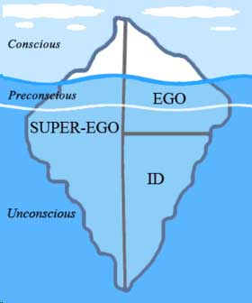
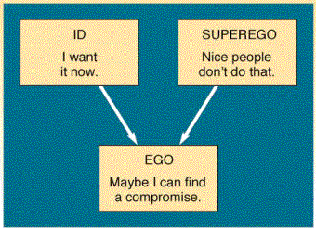
Freud (Notes)
ID: The id demands immediate satisfaction and when this happens we experience pleasure, when it is denied we experience ‘unpleasure’ or pain. The id is not affected by reality, logic or the everyday world.
Ego: The ego develops in order to mediate between the unrealistic id and the external real world. It is the decision making component of personality. Ideally the ego works by reason whereas the id is chaotic and totally unreasonable.
Superego: The superego incorporates the values and morals of society which are learned from one's parents and others. It develops around the age of 3 – 5 during the phallic stage of psychosexual development.
The superego's function is to control the id's impulses, especially those which society forbids, such as sex and aggression. It also has the function of persuading the ego to turn to moralistic goals rather than simply realistic ones and to strive for perfection.

Slide 5
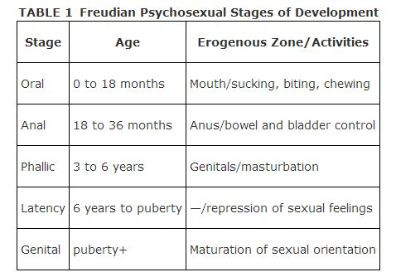
Psychosexual Development (No Notes)

Slide 6
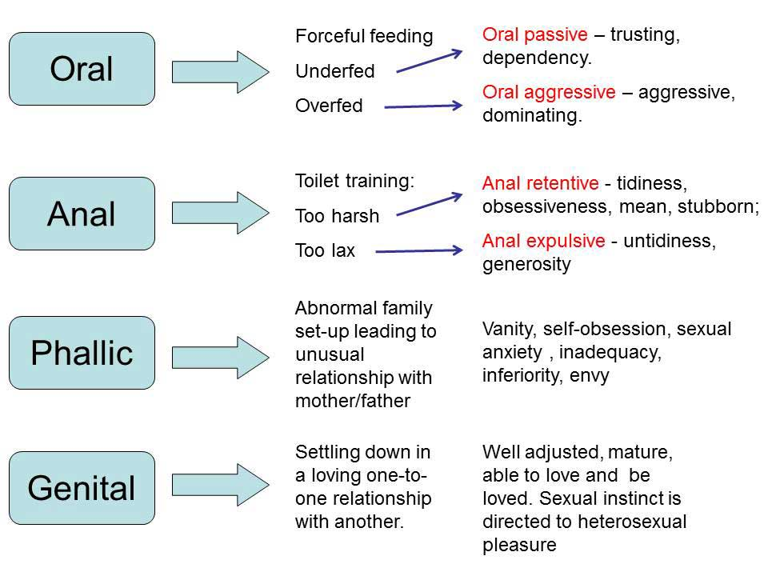

Slide 7
Little Hans
Prep: look up little Hans

Slide 8
Evaluation of the psychoanalytic model
Strengths
The psychodymamic model has a number of strengths which account for its enduring popularity:
Many observations of psychodynamic therapists appear to be borne out in everyday life, e.g., defence mechanisms
Many people with psychological disturbances do recollect childhood traumas
Freudian theory provides a comprehensive framework to describe human personality
Freud ‘rehumanised’ the distressed, making their suffering more comprehensible to the rest of society
By developing a method of treatment, Freud encouraged a more optimistic view regarding psychological distress. Mental illness could, in some cases at least, be treated!
Weaknesses of the psychoanalytic model are:
The tendency to ignore the patient’s current problems by focusing on past conflicts (though this is not true of many later versions of psychoanalysis)
A lack of scientific evidence concerning major theoretical assumptions
As the source of many of the conflicts are often parents, there is a tendency to give a lot of responsibility to parents for the psychological health of their children
Psychodynamic theory underestimates the role of situation and context, and overemphasises internal instincts and conflicts

Slide 9
Question
Outline key features of the psychodynamic approach to psychopathology.
Psychopathology is a term which refers to either the study of mental illness or mental distress or the manifestation of behaviours and experiences which may be indicative of mental illness or psychological impairment.

Slide 10
Answer
Key features include: • Role of the unconscious • Structure of the mind: id, ego, superego • Psychosexual stages of development • Use of defence mechanisms • Early childhood experiences affecting adult behaviour. Breadth/depth trade off; candidates may offer several features in less detail or a few features but in more detail.
Must relate to mental disorders

Slide 11
Psychodynamic Approach Assumptions
Our behaviour and feelings are powerfully affected by unconscious motives.
Our behaviour and feelings as adults (including psychological problems) are rooted in our childhood experiences.
All behaviour has a cause (usually unconscious), even slips of the tongue. Therefore all behaviour is determined.
Personality is made up of three parts (i.e. tripartite): the id, ego and super-ego.
Behaviour is motivated by two instinctual drives: Eros (the sex drive & life instinct) and Thanatos (the aggressive drive & death instinct). Both these drives come from the “id”.
Parts of the unconscious mind (the id and superego) are in constant conflict with the conscious part of the mind (the ego). This conflict creates anxiety, which could be dealt with by the ego’s use of defence mechanisms.
Personality is shaped as the drives are modified by different conflicts at different times in childhood (during psychosexual development).

Slide 12
Psychodynamic Therapies
Psychoanalysis involves a range of techniques that aims to bring material from the unconscious into the conscious.
Free Association
  The client is encouraged to express anything that comes into their mind and follow any associations that occur to them. The client must not censor the material, defence mechanisms will be lowered. The therapist identifies key themes from the free association to analyze later.
Dream Analysis
  "Dream are the royal road to the unconscious."
  During dreams the barriers to the unconscious are lifted.
  By analysing the dreams they can find out what is in your unconscious.
  Themes are identified and uncoded.
  Obvious content - Manifest content.
  Actual meaning lies beneath this - Latent content.
  Dreamwork to the process that turns latent into obvious.
  R o r s c h a c h T e s t Ink Blots is a type of projective test.
  Link

Slide 13
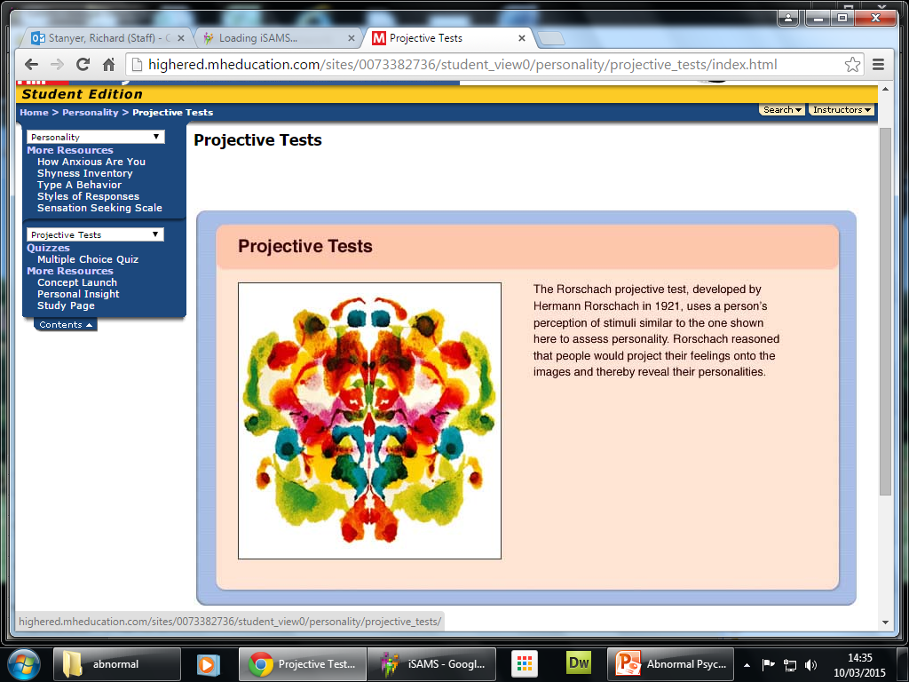

Slide 14


Evaluation
Hugely influential – many psychodynamic terms are in everyday use and Freud was the first to suggest ‘talking therapy’ – the basis for modern counselling
Doesn’t consider the role of adult experiences in abnormality e.g. divorce, bereavement, etc.
Based on case studies – may not be generalisable to general population
Blames parents for mental illness – consequences of their child rearing practices e.g. potty training
Case studies use retrospective self report data – P’s may not be truthful/may not remember accurately
Criticised as being unscientific because much of the theory is impossible to measure (not observable)
Often accused of being deterministic because it suggests that we have no control over our adult life – it is predetermined by childhood experiences

Slide 15
Question
Psychoanalysis is a beneficial therapy for some people. However, as with all therapies, it has limitations. Evaluate psychoanalysis as a therapy

Slide 16
Answer
The evaluation might consider:
  Therapy is very time-consuming and is unlikely to provide answers quickly.
  People must be prepared to invest a lot of time and money into the therapy; they must be motivated.
  They might discover some painful and unpleasant memories that had been repressed, which causes them more distress.
  This type of therapy does not work for all people and for all types of disorders. Evaluation which is focused on the psychodynamic approach can be credited as long as it is used to evaluate the therapy.

Slide 17
Question
There are various types of psychological therapy for treating abnormality.
  12 (a) Outline what is involved in psychoanalysis.

Slide 18
Answer
Psychoanalysis involves a range of techniques that aims to bring material from the unconscious into the conscious. These could include free association, dream analysis and projective tests.

Slide 19
Question
Outline two techniques used in psychoanalysis. 4

Slide 20
Answer
Psychoanalysis involves a range of techniques that aims to bring material from the unconscious into the conscious. These could include free association, dream analysis and projective tests. However, examiners should be mindful that psychoanalysis is a broad term and can include a wide range of different techniques. Students must offer two different techniques; they do not have to be outlined in equal detail. If only one technique, maximum 2 marks.

